Slide 1
Habit #1
Be Proactive
Based on the work of Stephen Covey

Slide 2
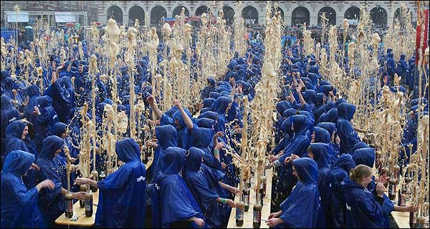
What happens to a bottle of soda when you shake it up?
It EXPLODES!

Slide 3
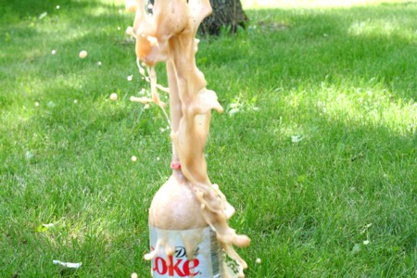
Journal Entry or
Discussion Starter:
Sometimes things go wrong, and we feel shaken up. As a result, we might EXPLODE on someone or something. This is called being REACTIVE. Has this ever happened to you? Explain what happened and why. Was this a good way to let go of all of your feelings? Why or why not?

Slide 4
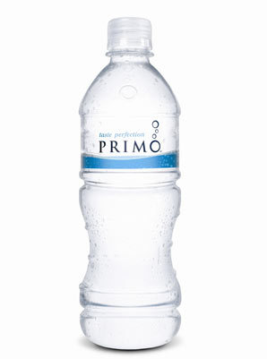
When you are PROACTIVE, you make a choice about how you react to the things that happen in your life. You act like a water bottle. You might get shaken up or mad, but you stay calm and don’t explode!

Slide 5
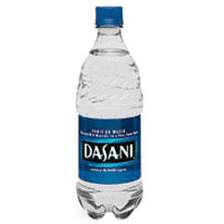
Journal Entry or
Discussion Starter:
Is it hard to stay calm
(like a water bottle) even when things don’t go your way?
Why or why not?
What steps could you take to be more PROACTIVE and calm when things aren’t going well?

Slide 6
Proactive vs. Reactive
When you are PROACTIVE, you make good choices about how you respond to something happening. You are always ready with a calm attitude. You do things to make sure that the right things will happen. You are prepared for anything that might happen. When things don’t go your way, you aren’t happy, BUT you stay calm.
When you are REACTIVE, you could explode at any minute. Things happen and they “catch you off guard”. You aren’t ready for things that might happen. You deal with things when they happen instead of being prepared.

Slide 7
Where do you fall?
Very
Reactive
Very
Proactive
How could you be more proactive?

Slide 8
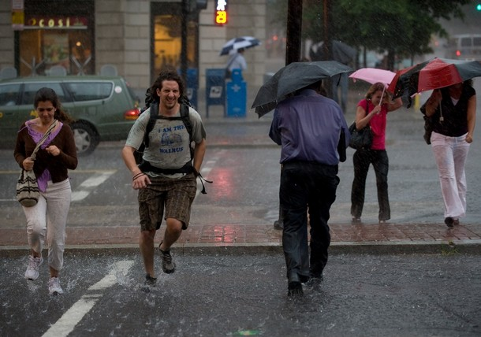
How do you feel on days like this?

Slide 9
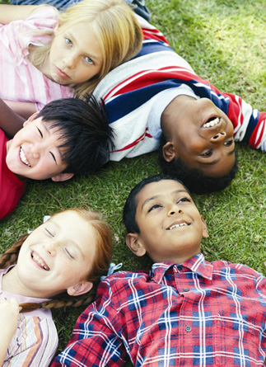
What about sunny days like this?

Slide 10

If you could “carry the weather with you”….
you could have a
good day no matter
what comes your way.

Slide 11

Journal Entry or
Discussion Starter:
Do you think it is possible to carry your weather with you? What do you think this means? How would your life be different if you could carry happiness or peace with you no matter what things happen?

Slide 12
Circle of Influence
Things you can’t control
circle of
circle
of
influence
Things you can control or change
concern
Focus on things you can change or influence

Slide 13
Circle of Influence
Things you CAN’T control or change:
Other people
The weather
Things you did wrong in the past
How other people treat me
Homework
Things you CAN control or change:
Your attitude
Your mood
Your reaction to good and bad things that happen
How I treat other people
Can you think of other examples from your life?

Slide 14
Be Proactive
Change how you handle things. Make a choice to be positive and focus on those things that YOU can change.
Make a positive difference in your family, your class, your school and the world!

Slide 15
Credits:
This slide show was created by
Rebecca Radicchi using the following resources.
The Seven Habits for Highly Effective People by Stephen Covey
The Seven Habits for Highly Effective Kids by Sean Covey
The Seven Habits for Highly Effective Teens by Sean Covey

