Slide 1
“Trouble in the Oceans”

Slide 2
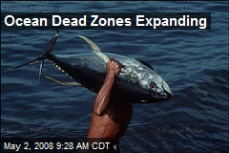
1.) In paragraph 1, what is the effect of lack of oxygen on the animals that live on the sea floor?
A dead zone is an area of the ocean that can no longer support aquatic life. This happens when the sea floor has very little or no oxygen. Without oxygen, fish, crabs, and other aquatic animals cannot live. As a result, they either die or migrate.
The effect of lack of oxygen on the animals that live on the sea floor is that they die or migrate.

Slide 3
2.) Reread the last sentence in the section “Nutrients Gone Awry.” What is the effect of algae on aquatic life?
As a result, the algae suck up the oxygen, leaving little breathing room for the other aquatic life.
The effect of algae on aquatic life is they leave little breathing room for other aquatic life because they suck up the oxygen.

Slide 4
3.) Read sentences two and three in the section “Nutrients Gone Awry.” What word helps you know things are being contrasted? What two things are being contrasted?
Fertilizers contain essential nutrients for the growth of crops. However, chemicals in fertilizer are harmful to our oceans.
The word “however” helps me know things are being contrasted. The two things being contrasted are the effects of fertilizers on crops and the effect of fertilizers on oceans.

