Slide 1
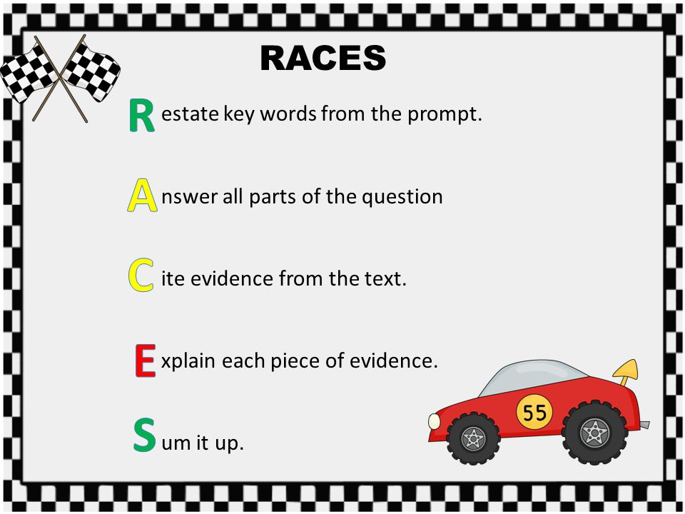
Special thanks to Mrs. Farley and Mrs. Weston!
Inspired by your creativity and grateful for the sharing!
Developed by Caryn Dingman DDES October 2016

Slide 2


Restate the question & answer it
cite evidence
from the passage
explain the evidence
OR make a connection
name each passage by title ☺
Developed by Caryn Dingman DDES October 2016

Slide 3

Developed by Caryn Dingman DDES October 2016

Slide 4

Developed by Caryn Dingman DDES October 2016

Slide 5
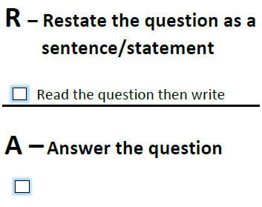
Source: free RACES graphic organizer teacherspayteachers.com/ author Sarah Connors
Developed by Caryn Dingman DDES October 2016

Slide 6
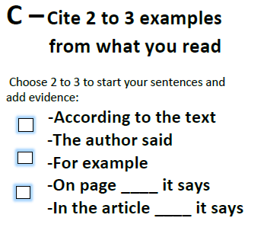
Source: free RACES graphic organizer teacherspayteachers.com/ author Sarah Connors
Developed by Caryn Dingman DDES October 2016

Slide 7
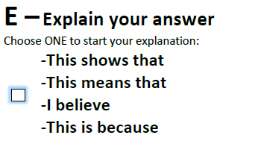
Source: free RACES graphic organizer teacherspayteachers.com/ author Sarah Connors
Developed by Caryn Dingman DDES October 2016

Slide 8
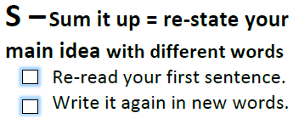
Source: free RACES graphic organizer teacherspayteachers.com/ author Sarah Connors
Developed by Caryn Dingman DDES October 2016

