Slide 1
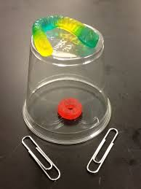
Can you save Fred?

Slide 2
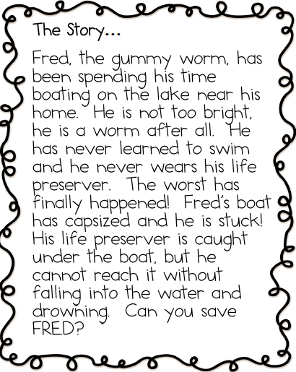

Slide 3
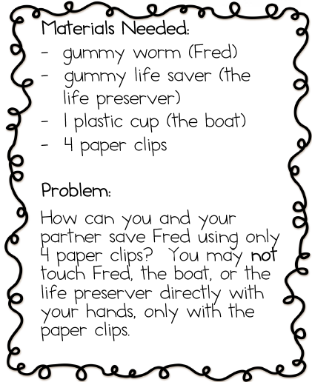
Remember!
Your may NOT
touch Fred
touch the boat
or touch the life preserver with your hands!

Slide 4
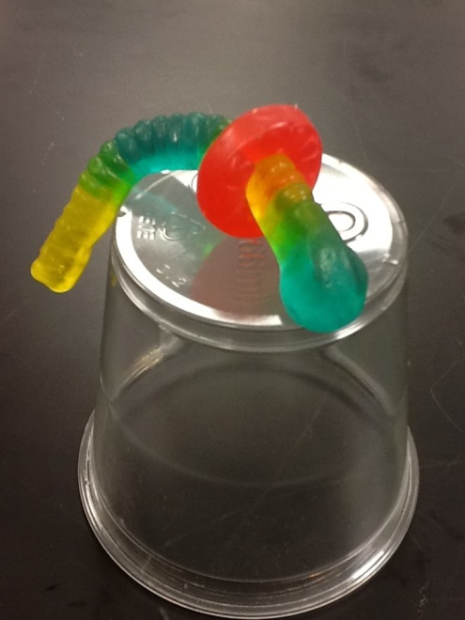
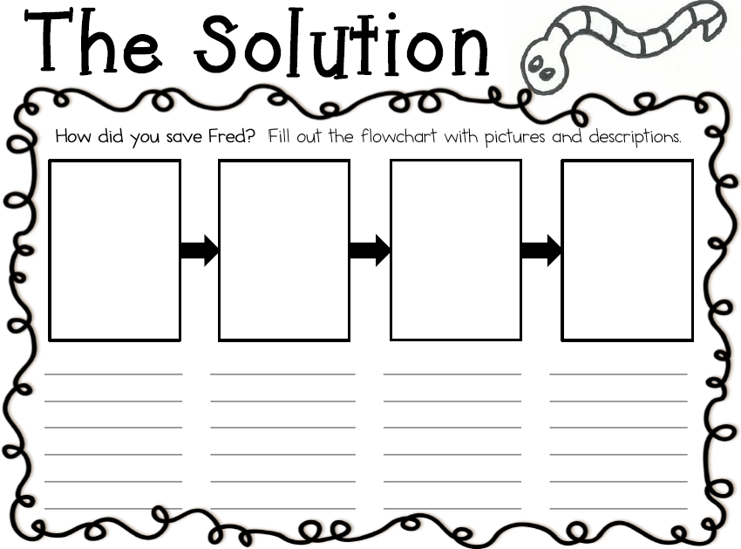
You and your partner will fill out this chart in your Science Notebooks.

