Slide 1

Introducing
RACES
What exactly is RACES?
It’s a tool for you to use! It will help guide you to properly respond to questions about what you have read.
When can I use RACES?
As we just read, use it anytime you have to respond to something you have read! This could be in your English, Science, or Social Studies classes!
WOW!
RACES = awesome!

Slide 2
Let’s break it down!
R – Restate the question
A – Answer the question
C – Cite specific evidence from text(s)
E – Explain your thinking
S – Sum it up
R
A
C
E
S
These two work together! Basically, you restate the question being asked and provide the answer to that question. You MUST use the wording from the question when you “restate” it! **This is your introduction and topic sentence.** (Typically, this is more than one sentence!!)
This is the MOST IMPORTANT part!! You have to prove what you say is correct. How? It’s simple! You provide specific details from the text read that helps support your answer. This is text evidence! **These are your supporting sentences.**
The conclusion is the easy part! All you have to do is wrap-up your answer . It may help to remember that you should refer back to your reason for writing (that’s the question) in your conclusion. **This is your concluding sentence.**

Slide 3
I’m not sure about text evidence. Can we talk about this some more?
Of course we can talk about it more!!!
Suppose a man is sitting in a courtroom facing burglary charges. He then learns that there is evidence which puts him at the scene of the crime.
OH NO!!
What does evidence mean? PROOF
Does this mean the court of law will PROVE he committed the crime?
You got it! The court has PROOF because they have EVIDENCE!

Slide 4
So, how does this relate to RACES?
You will PROVE your answer is correct by providing EVIDENCE from the TEXT!!
You MUST support your answer by providing specific information from the literature. This is TEXT EVIDENCE! You are giving PROOF from the TEXT!
So, basically, I have to pull details from what I’ve read and put it into my answer as proof that I am correct?
You got it!

Slide 5
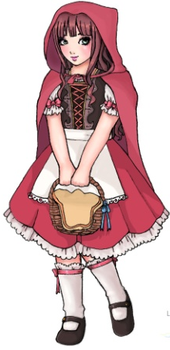
Let’s give RACES a try!
Is Little Red Riding Hood a responsible young lady? Support your answer with information from the story.
R
A
C
E
S
Little Red Riding Hood is not a responsible young lady. There are many instances in the story that help prove this answer.
When she first starts traveling towards her grandmother’s house, she gets off task and starts to pick flowers. Her mother specifically told her that she should stay on the path and go straight to her grandmother’s home. In addition, Red talks to a wolf while she is in the forest. This wolf is a stranger, and she has a conversation with him despite her mother’s warnings to avoid unfamiliar people. Furthermore, Red gives personal information about herself to the wolf by informing him that she is heading to her grandmother’s house.
Clearly, Little Red Riding Hood is not responsible. This irresponsibleness is seen when she does not stay focused on her errand and talks to a stranger about her personal plans.
Why can’t I just say she is not responsible because she doesn’t do what she’s told? This does not provide any specific details from the story! That is not PROOF. It’s only your opinion until you provide EVIDENCE!

Slide 6
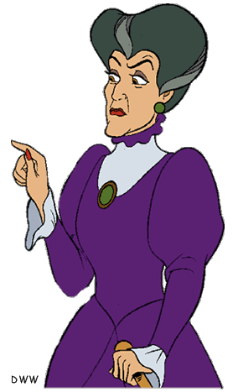
Let’s give RACES another try!
SHAME ON YOU, NAUGHTY CHILD!!
Is Cinderella’s step-mother a good role model? Support your answer with information from the story.
R
A
C
E
S
No, she is a mean lady. There are many parts in the story to prove this is true.
The evil step-mother treats Cinderella unfairly. She is very mean and cruel. She makes Cinderella do a lot of stuff around the house too.
This is why her step-mother is not a good role model.
THIS IS A TERRIBLE ANSWER!!
We’ll give this another try before we get punished!
Why is it terrible? The question is not restated, and there are no specific details from the story! Remember, you must provide EVIDENCE!

Slide 7
Let’s give RACES another try!
Is Cinderella’s step-mother a good role model? Support your answer with information from the story.
R
A
C
E
S
Cinderella’s step-mother is not a good role model. She treats Cinderella cruelly and is quite cold-hearted. There are many details from the story to support this.
The evil step-mother treats Cinderella unfairly. For example, she makes Cinderella clean the castle, while her own daughters have no chores. In fact, Cinderella must also clean up after her step-sisters who are quite capable of picking up after themselves. The step-mother is also very cruel. At one point in the story, she forbids Cinderella to go to the ball, despite the Prince’s request that every young woman in the kingdom attend. Even though she knew Cinderella desperately wanted to go, her step-mother refuses.
The unjust actions of this cruel step-mother makes her a terrible role model.
That’s much better because there are specific details from the story to PROVE that your answer (she’s not a good role model) is correct! Now there is EVIDENCE to support your answer!

Slide 8
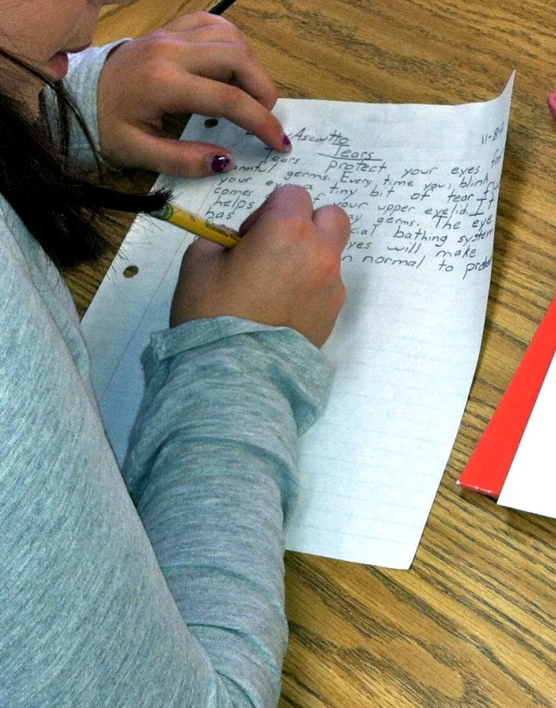

RACES is very specific about what should be included in your answer.
Remember, it is a tool to help guide you in properly answering questions.
Just like tools help build items, RACES will help you build a proper answer.
USE
THIS
TOOL!

