Slide 1
One-Step Multiplication Problems
Two-Step Multiplication Problems
One-Step Division Problems
Two-Step Division Problems
Draw a Bar Model
10
10
10
10
10
20
20
20
20
20
30
30
30
30
30
40
40
40
40
40
50
50
50
50
50
Notes:
You can add your own categories and points values to this game board. Enter your questions and answers in the slides we’ve provided.
When you’re in slide show view, select the underlined text to go to that question, then move to the answer slide. Use the left triangle to return to this game board slide.

Slide 2
One-Step Multiplication Problems questions follow

Slide 3
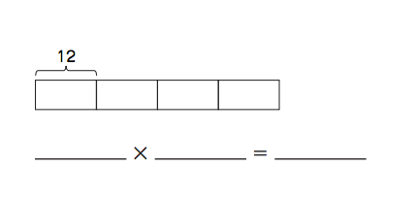
One-Step Multiplication Problems
What multiplication sentence does this bar model show?
10
Notes:
Enter your questions and answers in the placeholders. You can add the category and points value at the bottom for reference.
When you’re in slide show view, select the right triangle to reveal the answer. Select the left triangle to return to the game board slide.

Slide 4
One-Step Multiplication Problems
What is
12 x 4 = 48?
10
Notes:
Enter your questions and answers in the placeholders. You can add the category and points value at the bottom for reference.
When you’re in slide show view, select the left triangle to return to the game board slide.

Slide 5
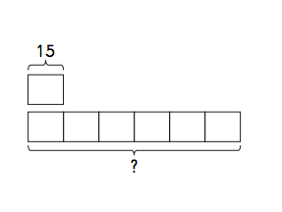
One-Step Multiplication Problems
What multiplication sentence does this bar model show? Solve.
20

Slide 6
One-Step Multiplication Problems
What is
15 x 6 = 90?
20

Slide 7
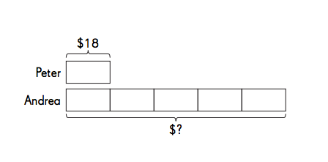
One-Step Multiplication Problems
Solve. Use the bar model to help.
Peter has $18. Andrew has 5 times as much money. How much money does Andrea have?
30

Slide 8
One-Step Multiplication Problems
What is
$18 x 5 = $90?
Andrea has $90.
30

Slide 9
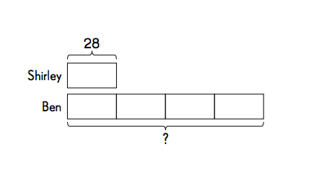
One-Step Multiplication Problems
Solve. Use the bar model to help you.
Shirley has 28 llamas on her farm. Ben has 4 times as many llamas. How many llamas does Ben have?
40

Slide 10
One-Step Multiplication Problems
What is
28 x 4 = 112 llamas?
Ben has 112 llamas.
40

Slide 11
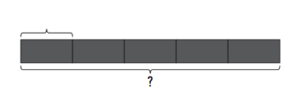
One-Step Multiplication Problems
Solve. Use the bar model to help you.
Brett saves $213 per month. How much money will he save in five months?
$213
50

Slide 12
One-Step Multiplication Problems
What is $213 x 5 = $1065?
Ben will save $1065 in five months.
50

Slide 13
Two-Step Multiplication Problems questions follow

Slide 14
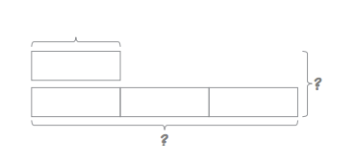
Two-Step Multiplication Problems
Solve. Use the bar model to help you.
In the fall, 21 students join Board Games Club. In the spring, three times as many students join. How many total students are in the club at the end of the spring? (Don’t forget that the students from the fall are still in the club!)
21
10

Slide 15
Two-Step Multiplication Problems
What is 84 students?
Explanation: 21 x3 = 63 students in the spring.
63 + 21 students = 84 total students.
10

Slide 16
Two-Step Multiplication Problems
Solve both parts of this problem. You may draw a bar model to help.
Mrs. O’Connor buys 24 boxes of crayons for her class in September. Each box contains 8 crayons. By November, 56 crayons are used up.
How many crayons did Mrs. O’Connor’s class have in September?
How many crayons are left in November?
20

Slide 17
Two-Step Multiplication Problems
What is
A) 24 x 8 = 192 crayons?
B) 192 – 56 = 136 crayons left?
20

Slide 18
Two-Step Multiplication Problems
Each grade at a school has 25 students in one class and 18 students in the other. There are 5 grades in the school. How many students are in the school all together?
30

Slide 19
Two-Step Multiplication Problems
What is 225 students?
Explanation: 25 + 18 = 43 students in each grade.
43 x 5 = 215 students in all
30

Slide 20
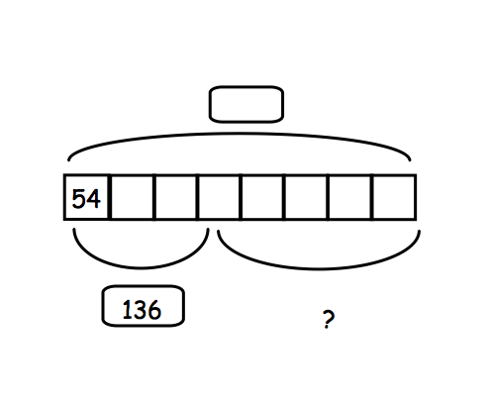
Two-Step Multiplication Problems
There are 8 packs of blue-and-yellow construction paper. Each pack has 54 sheets.
If there are a total of 136 yellow sheets, how many sheets are blue?
40

Slide 21
Two-Step Multiplication Problems
What is 296 blue sheets?
Explanation: 54 x 8 = 432 sheets.
432 – 136 yellow = 296 blue
40

Slide 22
Two-Step Multiplication Problems
Mrs. O’Connor buys a new TV.
She pays $525 in the first month and $241 for the next four months. What was the total cost of the TV?
50

Slide 23
Two-Step Multiplication Problems
What is $1,489?
$241 x 4 = $964
$964 + $525 = $1,489
50

Slide 24
One-Step Division Problems questions follow

Slide 25
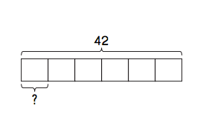
One-Step Division Problems
What division sentence does this bar model show?
10

Slide 26
One-Step Division Problems
What is 42 ÷ 6 = 7?
10

Slide 27
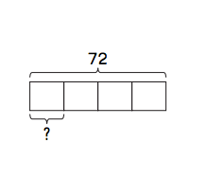
One-Step Division Problems
What division sentence does this bar model show?
20

Slide 28
One-Step Division Problems
What is 72 ÷ 4 = 18?
20

Slide 29
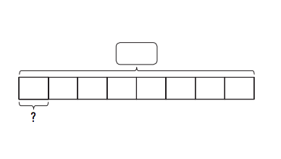
One-Step Division Problems
Solve. Use the bar model to help.
Mrs. Fickert has 136 pineapples. She puts them equally into 8 boxes before shipping them back to Hawaii, because nobody needs that many pineapples. How many pineapples go in each box?
30

Slide 30
One-Step Division Problems
What is 136 ÷ 8 = 17 pineapples?
30

Slide 31
One-Step Division Problems
A bookshelf has twice as many fiction books as non-fiction books. If the shelf has 84 total books, how many are non-fiction?
40

Slide 32
One-Step Division Problems
What is 28 non-fiction books? Explanation: 84 ÷ 3 (2 parts fiction, 1 part non-fiction) = 28.
40

Slide 33
One-Step Division Problems
Margaret has 648 coins.
She arranges them in her coin book so that each page has 8 coins.
How many pages are needed to hold all of Margaret’s coins?
50

Slide 34
One-Step Division Problems
What is 81 pages?
50

Slide 35
Two-Step Division Problems questions follow

Slide 36
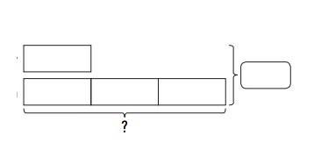
Two-Step Division Problems
In a math competition, Gabriel completes three times as many problems as Harry.
Both of them complete 72 problems.
How many problems does Gabriel complete?
72
10

Slide 37
Two-Step Division Problems
What is 54 problems?
Explanation: 72÷4 = 18. (Harry’s problems.)
18 x 3 = 54. (Gabriel)
10

Slide 38
Two-Step Division Problems
Mr. Adlin buys 862 baseballs and bats.
He keeps all of the 254 baseballs in a box. He packs all of the bats equally into 4 crates.
a. How many baseballs does Mr. Adlin buy?
b. How many bats are packed into each crate?
20

Slide 39
Two-Step Division Problems
What is
608 bats
152 in each crate?
20

Slide 40
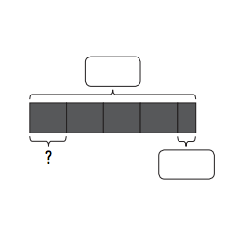
Two-Step Division Problems
Mrs. Fickert arranges her photos of Drew into four albums. She has three photos left over.
If she started with 71 photos,
How many photos go into each album?
30

Slide 41
Two-Step Division Problems
What is 17 in each album?
Explanation: 71-3 = 68
68 ÷ 4 = 17
30

Slide 42
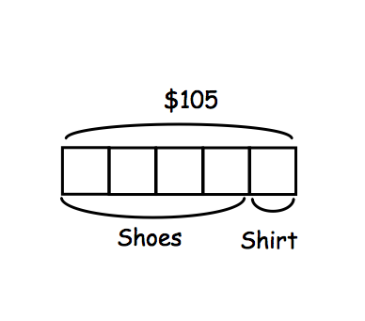
Two-Step Division Problems
Ms. Heim spends $105 on a new pair of running shoes and a t-shirt. The shoes cost 4 times as much as the t-shirt. How much did the shoes cost?
40

Slide 43
Two-Step Division Problems
What is $84?
Explanation: $105 ÷ 5 = $21 (cost of shirt). $21 x 4 = $84
40

Slide 44
Two-Step Division Problems
Mrs. Van Thuyne packs Xavier’s 72 toys neatly into boxes. Each box contains 4 toys. She puts away 10 boxes. How many boxes are left?
50

Slide 45
Two-Step Division Problems
What is 8 boxes?
Explanation: 72 ÷ 4 = 18. 18-10 = 8 boxes left.
50

Slide 46
Draw a Bar Model questions follow

Slide 47
Draw a Bar Model
Draw the bar model for this problem. Solve for a bonus point after your teacher checks.
A Wii costs 5 times as much as a Wii game. The Wii costs $430. What is the cost of the game?
10

Slide 48
Draw a Bar Model
10

Slide 49
Draw a Bar Model
Draw the bar model for this problem. Solve for a bonus point after your teacher checks.
At the beach, 8 children pick up a total of 112 seashells. They share the seashells equally. How many seashells does each child have?
20

Slide 50
Draw a Bar Model
20

Slide 51
Draw a Bar Model
Draw the bar model for this problem. Solve for a bonus point after your teacher checks.
Ms. Whyte buys a reading group table and 8 identical chairs for $294. The table costs $198. How much does each chair cost?
30

Slide 52
Draw a Bar Model
30

Slide 53
Draw a Bar Model
Draw the bar model for this problem. Solve as a bonus.
There are 48 boys and 37 girls in two classes at field day. All the children are grouped into 5 equal teams. How many children are there on each team?
40

Slide 54
Draw a Bar Model
40

Slide 55
Draw a Bar Model
Draw the bar model for this problem. Solve as a bonus.
Landon has twice as many fruit snacks as Olivia.
Henry has 3 times as many fruit snacks as Landon.
Henry has 138 fruit snacks. How many does Olivia have?
50

Slide 56
Draw a Bar Model
50

