Slide 1
Math Vocabulary Numbers and Operations M05.A-T multiplying & dividing decimals
Aligning with
Pennsylvania Department of Education
Core Assessment Anchors
and enVision Math Textbook Topic 7
©2012-2014 Caryn Dingman
www.mrsdingman.com

Slide 2
multiply decimals by 10, 100, 1000
Multiply by: | Move Decimal Point to the Right:
1 | 0 places
10 | 1 place
100 | 2 places
1000 | 3 places
Example:
1 X .45 = .45
100 X .45 = 45.00
10 X .45 = 4.5
1000 X .45 = 450.00
©2012-2014 Caryn Dingman www.mrsdingman.com
enVision Topic 7
PA Core Assessment Anchor MO5.A-T

Slide 3
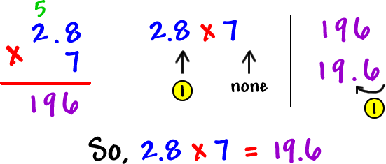
multiply decimals by a whole number
1. Multiply as if each factor was a whole number.
2. Count the number of digits after the decimal point in each factor.
3. Move that total number of digits from the right to place decimal point in the product.
©2012-2014 Caryn Dingman www.mrsdingman.com
enVision Topic 7
PA Core Assessment Anchor MO5.A-T

Slide 4
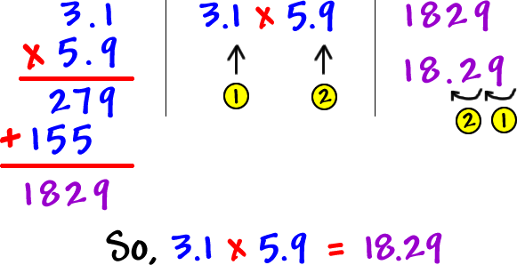
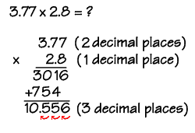
multiply decimals by decimals
©2012-2014 Caryn Dingman www.mrsdingman.com
enVision Topic 7
PA Core Assessment Anchor MO5.A-T

Slide 5
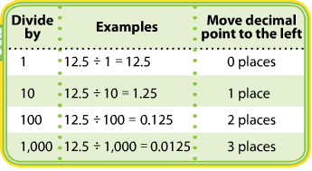
divide decimals by 10, 100, 1000
©2012-2014 Caryn Dingman www.mrsdingman.com
enVision Topic 7
PA Core Assessment Anchor MO5.A-T

Slide 6
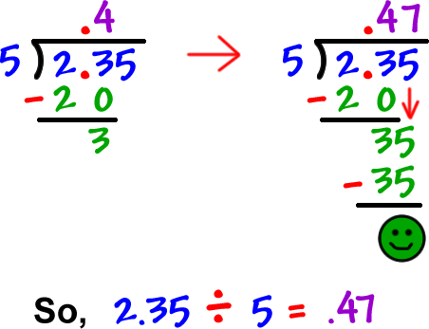
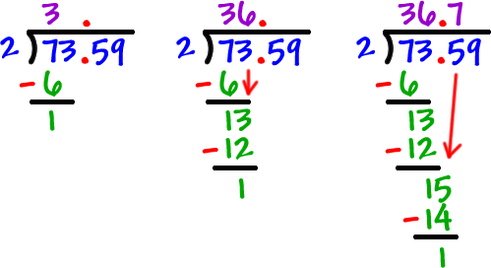
divide decimals by whole number
1. Place decimal point in quotient BEFORE beginning division.
2. Divide as though dividend is a whole number.
©2012-2014 Caryn Dingman www.mrsdingman.com
enVision Topic 7
PA Core Assessment Anchor MO5.A-T

