Slide 1
Math Vocabulary Numbers and Operations M05.A-T multiplying whole numbers/exponents
Aligning with
Pennsylvania Department of Education
Core Assessment Anchors
and enVision Math Textbook Topic 3
©2011-2014 Caryn Dingman
www.mrsdingman.com

Slide 2
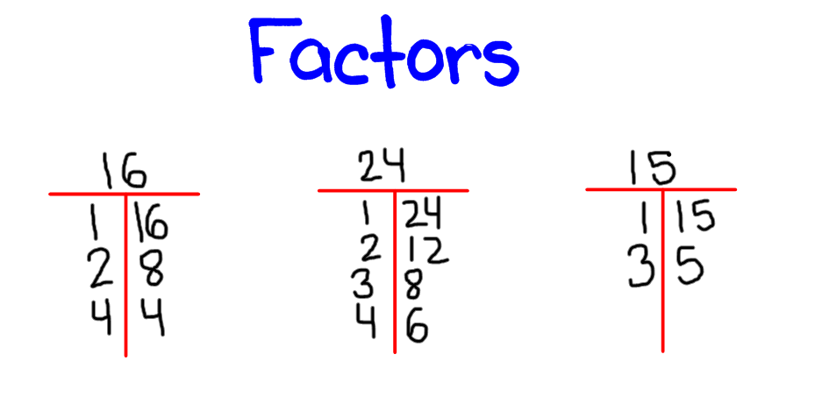
factor
* a number we multiply
* a whole number we can divide evenly into another whole number
examples:
©2011-2014 Caryn Dingman www.mrsdingman.com
enVision Topic 3
PA Assessment Anchor MO5.A-T

Slide 3
multiple
* a product (synonym)
* the answer to a multiplication problem
examples:
multiples of 4: 4, 8, 12, 16
multiples of 3: 3, 6, 9, 12
©2011-2014 Caryn Dingman www.mrsdingman.com
enVision Topic 3
PA Assessment Anchor MO5.A-T

Slide 4
product
* a multiple (synonym)
* the answer to a multiplication problem
examples:
products of 4: 4, 8, 12, 16
products of 3: 3, 6, 9, 12
©2011-2014 Caryn Dingman www.mrsdingman.com
enVision Topic 3
PA Assessment Anchor MO5.A-T

Slide 5
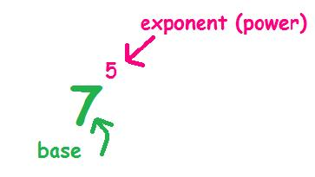
base
* a number that is multiplied by itself when raised to a power
example:
* this means to multiply “7” 5 times
* 7 x 7 x 7 x 7 x 7
©2011-2014 Caryn Dingman www.mrsdingman.com
enVision Topic 3
PA Assessment Anchor MO5.A-T

Slide 6
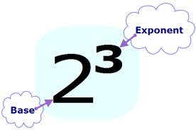
exponent
* a number that tells how many times the base number is used as a factor
example:
* this means to multiply 2 “3” times
* 2 X 2 X 2
©2011-2014 Caryn Dingman www.mrsdingman.com
enVision Topic 3
PA Assessment Anchor MO5.A-T

Slide 7
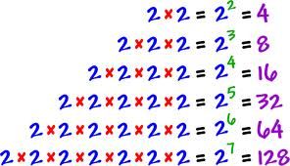
exponential notation
* may also be called exponent form OR exponential expression
exponential notation
examples:
©2011-2014 Caryn Dingman www.mrsdingman.com
enVision Topic 3
PA Assessment Anchor MO5.A-T

Slide 8
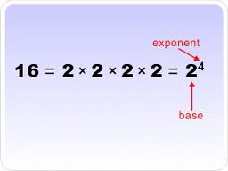
expanded form (exponents)
* a way to write a number with exponents that shows the base number as a factor
example:
“2 X 2 X 2 X 2”
is expanded form of 2⁴
©2011-2014 Caryn Dingman www.mrsdingman.com
enVision Topic 3
PA Assessment Anchor MO5.A-T

Slide 9
standard form (exponents)
* common way to write a number
example:
“16”
is standard form of 2⁴
©2011-2014 Caryn Dingman www.mrsdingman.com
enVision Topic 3
PA Assessment Anchor MO5.A-T

Slide 10
squared
* a name for a number to the second power
* a name for a number multiplied by itself or used as a factor 2 times
example:
©2011-2014 Caryn Dingman www.mrsdingman.com
enVision Topic 3
PA Assessment Anchor MO5.A-T

Slide 11
cubed
* a name for a number to the third power
* a name for a number multiplied by itself or used as a factor 3 times
this means cubed or to the third power
©2011-2014 Caryn Dingman www.mrsdingman.com
enVision Topic 3
PA Assessment Anchor MO5.A-T

Slide 12
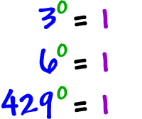
exponent rules
* any number to the first power = itself
* any number to the zero power = one
©2011-2014 Caryn Dingman www.mrsdingman.com
enVision Topic 3
PA Assessment Anchor MO5.A-T

