Slide 1
Math Vocabulary Numbers and Operations M05.A-T add & subtract whole numbers & decimals
Aligning with
Pennsylvania Department of Education
Core Assessment Anchors
and enVision Math Textbook Topic 2
©2011-2014 Caryn Dingman
www.mrsdingman.com

Slide 2
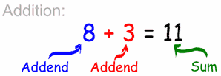
sum
* answer to an addition problem
©2011-2014 Caryn Dingman www.mrsdingman.com
enVision Topic 2
PA Assessment Anchor MO5.A-T

Slide 3
difference
* answer to a subtraction problem
©2011-2014 Caryn Dingman www.mrsdingman.com
enVision Topic 2
PA Assessment Anchor MO5.A-T

Slide 4
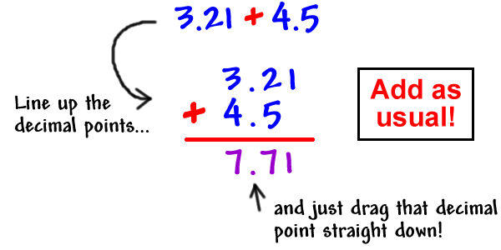
decimal addition
* line up decimal points
©2011-2014 Caryn Dingman www.mrsdingman.com
enVision Topic 2
PA Assessment Anchor MO5.A-T

Slide 5
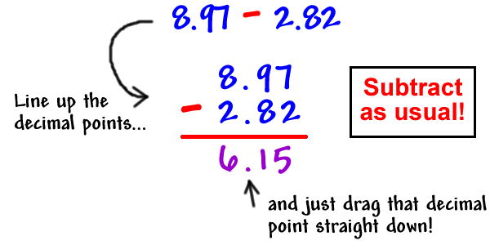
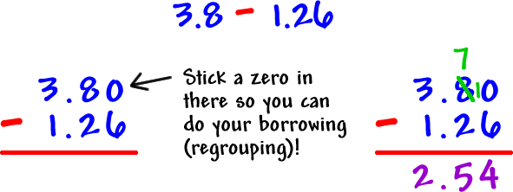
decimal subtraction
* line up decimal points
©2011-2014 Caryn Dingman www.mrsdingman.com
enVision Topic 2
PA Assessment Anchor MO5.A-T

Slide 6
rounding decimals
* use a number line strategy ☺
* or circle and underline ☺
©2011-2014 Caryn Dingman www.mrsdingman.com
enVision Topic 2
PA Assessment Anchor MO5.A-T

