Slide 1
Math Vocabulary
Numbers and Operations M05.A-T place value whole numbers & decimals
Aligning with
Pennsylvania Department of Education
Core Assessment Anchors
and enVision Math Textbook Topic 1
©2011-2014 Caryn Dingman
www.mrsdingman.com

Slide 2
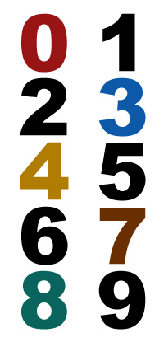
digit
* symbol used to show a number
©2011-2014 Caryn Dingman www.mrsdingman.com
enVision Topic 1
PA Assessment Anchor MO5.A-T

Slide 3
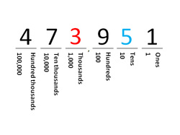
value
* how much a digit is worth
* value decided by position of digit
value = 3,000
value = 50
©2011-2014 Caryn Dingman www.mrsdingman.com
enVision Topic 1
PA Assessment Anchor MO5.A-T

Slide 4
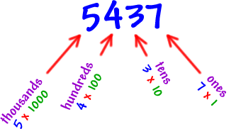
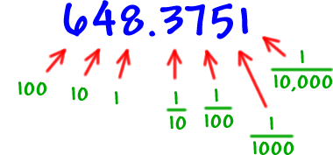
standard form
* a way of writing numbers using digits
©2011-2014 Caryn Dingman www.mrsdingman.com
enVision Topic 1
PA Assessment Anchor MO5.A-T

Slide 5

expanded form
* a way to write a number
* shows the sum of each place
©2011-2014 Caryn Dingman www.mrsdingman.com
enVision Topic 1
PA Assessment Anchor MO5.A-T

Slide 6
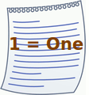
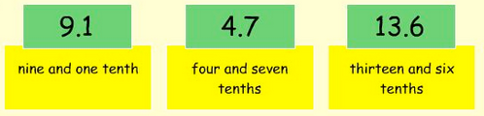
word form
* a way to write a number
* uses words instead of digits
©2011-2014 Caryn Dingman www.mrsdingman.com
enVision Topic 1
PA Assessment Anchor MO5.A-T

Slide 7
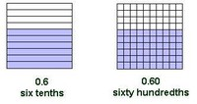
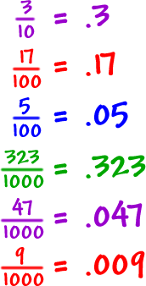
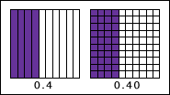
equivalent decimals
* decimals that name the same amount
©2011-2014 Caryn Dingman www.mrsdingman.com
enVision Topic 1
PA Assessment Anchor MO5.A-T

Slide 8
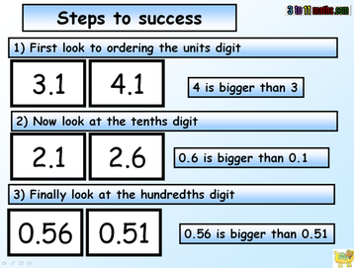
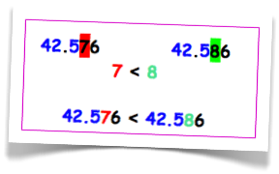
comparing decimals
* look for the digit where the value changes
©2011-2014 Caryn Dingman www.mrsdingman.com
enVision Topic 1
PA Assessment Anchor MO5.A-T

Slide 9
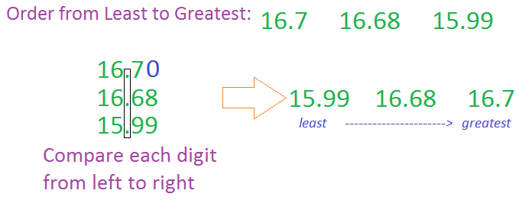
ordering decimals
* line up vertically (one under the other)
* add place holder zeroes so each has same number of digits after decimal point
©2011-2014 Caryn Dingman www.mrsdingman.com
enVision Topic 1
PA Assessment Anchor MO5.A-T

