Slide 1
Math Vocabulary
PACS M05.D-M Measurement & Data
PACS M06.D-S Statistics & Probability
Aligning with
Pennsylvania Department of Education
Core Assessment Anchors
and enVision Math Textbook Topic 18
©2011-2015 Caryn Dingman
www.mrsdingman.com

Slide 2

types of graphs
* bar graph:
compares data
* line graph:
shows change over time
* circle graph:
shows parts of whole
also called pie chart
©2011-2015 Caryn Dingman www.mrsdingman.com
Measurement & Data/ Statistics & Probability/ enVision Topic 18
PA Core Assessment Anchor MO5.D-M and M06.D-S

Slide 3


scale
* series, or group, of numbers
* numbers placed at fixed spots along one of the axis, or lines, of a graph
* changing distance between these fixed spots can make data easier to read on graph
©2011-2015 Caryn Dingman www.mrsdingman.com
Measurement & Data/ Statistics & Probability/ enVision Topic 18
PA Core Assessment Anchor MO5.D-M and M06.D-S

Slide 4
interval
* distance between numbers on scale of graph
*separates the distance into equal parts
*difference between 2 numbers next to each other on scale is the interval
interval is 1
interval is 10
©2011-2015 Caryn Dingman www.mrsdingman.com
Measurement & Data/ Statistics & Probability/ enVision Topic 18
PA Core Assessment Anchor MO5.D-M and M06.D-S

Slide 5
mean
* average
* a number that best represents all numbers in a series, or group
* to find average, or mean:
  1.) add all numbers in series
  2.) divide that sum by how many numbers are in series
Measurement & Data/ Statistics & Probability/ enVision Topic 18
PA Core Assessment Anchor MO5.D-M and M06.D-S
©2011-2015 Caryn Dingman www.mrsdingman.com

Slide 6
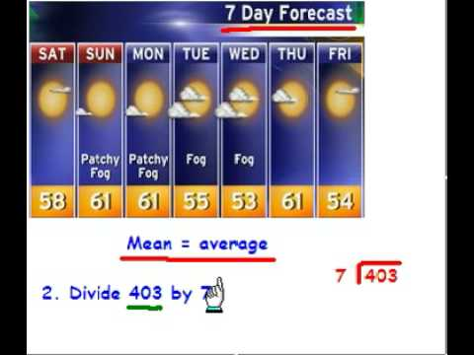
example: finding average or mean
58°
61°
61°
55°
53°
61°
+54°
403°
403 ÷ 7 = average temperature is about 58°
Measurement & Data/ Statistics & Probability/ enVision Topic 18
PA Core Assessment Anchor MO5.D-M and M06.D-S
©2011-2015 Caryn Dingman www.mrsdingman.com

Slide 7
median
* number in the middle of an ORDERED series, or group
* to find median:
  1.) order numbers from LEAST to GREATEST
  2.) Cross out numbers on each end until only one number is left
  3.) number that’s left is median
Measurement & Data/ Statistics & Probability/ enVision Topic 18
PA Core Assessment Anchor MO5.D-M and M06.D-S
©2011-2015 Caryn Dingman www.mrsdingman.com

Slide 8
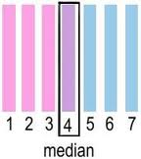
example:
finding median when series total is odd
X
X
X
X
X
X
©2011-2015 Caryn Dingman www.mrsdingman.com
Measurement & Data/ Statistics & Probability/ enVision Topic 18
PA Core Assessment Anchor MO5.D-M and M06.D-S

Slide 9
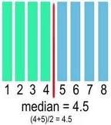
example:
finding median when series total is even
4 + 5 = 9
X
X
X
X
X
X
9 ÷ 2 = 4.5
Measurement & Data/ Statistics & Probability/ enVision Topic 18
PA Core Assessment Anchor MO5.D-M and M06.D-S
©2011-2015 Caryn Dingman www.mrsdingman.com

Slide 10
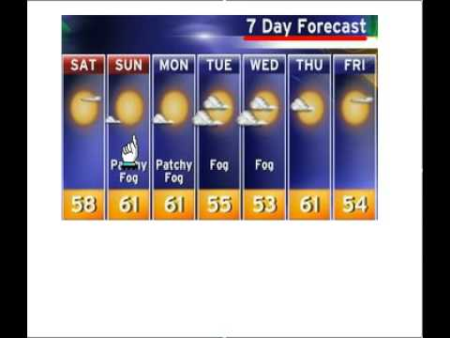
mode
* the number that occurs most often in a series
Mode is 61°
©2011-2015 Caryn Dingman www.mrsdingman.com
Measurement & Data/ Statistics & Probability/ enVision Topic 18
PA Core Assessment Anchor MO5.D-M and M06.D-S

Slide 11
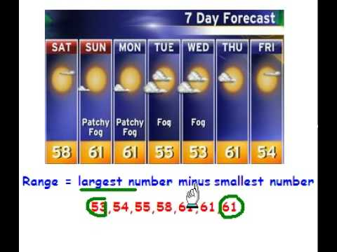
range
* the difference between the greatest and least numbers in series
61°
- 53°
8°
range:
8°
©2011-2015 Caryn Dingman www.mrsdingman.com
Measurement & Data/ Statistics & Probability/ enVision Topic 18
PA Core Assessment Anchor MO5.D-M and M06.D-S

