Slide 1
Math Vocabulary
Geometry M5.C-G
Aligning with
Pennsylvania Department of Education
Core Assessment Anchors
and enVision Math Textbook Topic 8
©2010-2015 Caryn Dingman
www.mrsdingman.com

Slide 2

polygon
* a closed plane figure
* having 3 or more straight sides
examples:
©2010-2015 Caryn Dingman www.mrsdingman.com
enVision Topic 8
PA Core Assessment Anchor M5.C-G

Slide 3
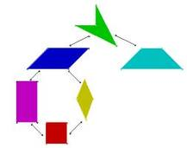
quadrilateral
* a closed plane figure (polygon)
* has 4 sides
examples:
©2010-2015 Caryn Dingman www.mrsdingman.com
enVision Topic 8
PA Core Assessment Anchor M5.C-G

Slide 4
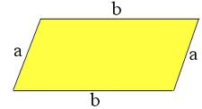
parallelogram
* a closed plane figure (polygon)
* has 4 sides (quadrilateral)
* pair of opposite sides are parallel
* pair of opposite sides are congruent
example:
©2010-2015 Caryn Dingman www.mrsdingman.com
enVision Topic 8
PA Core Assessment Anchor M5.C-G

Slide 5
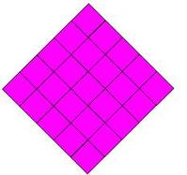
rhombus
* a closed plane figure (polygon)
* has 4 sides (quadrilateral)
* opposite sides are parallel (parallelogram)
* 4 sides are congruent (equal in length)
example:
©2010-2015 Caryn Dingman www.mrsdingman.com
enVision Topic 8
PA Core Assessment Anchor M5.C-G

Slide 6
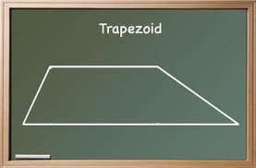
trapezoid
* a closed plane figure (polygon)
* has 4 sides (quadrilateral)
* has only ONE pair of parallel sides
example:
©2010-2015 Caryn Dingman www.mrsdingman.com
enVision Topic 8
PA Core Assessment Anchor M5.C-G

Slide 7
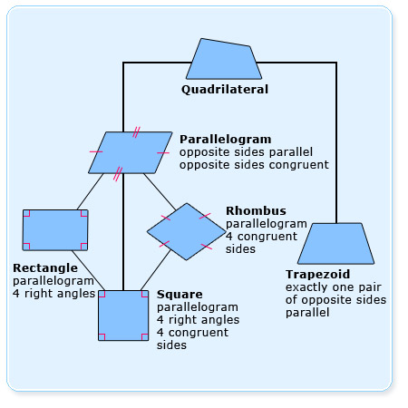
quadrilateral chart
©2010-2015 Caryn Dingman www.mrsdingman.com
enVision Topic 8
PA Core Assessment Anchor M5.C-G

