Slide 1
Math Vocabulary
Numbers and Operations M05.A-F multiply & divide fractions & mixed numbers
Aligning with
Pennsylvania Department of Education
Core Assessment Anchors
and enVision Math Textbook Topic 11
©2014-2015 Caryn Dingman
www.mrsdingman.com

Slide 2


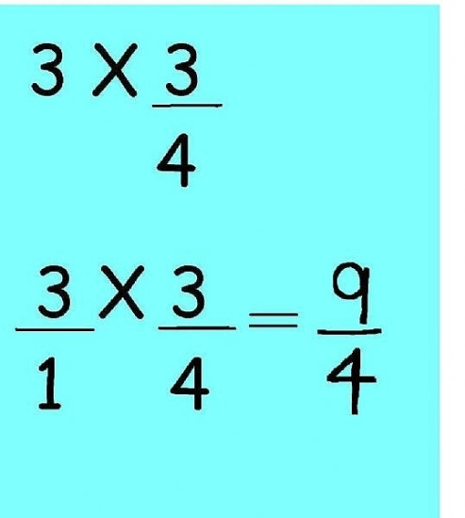
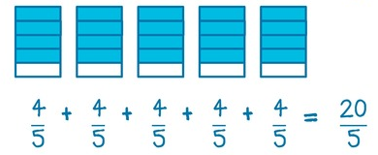
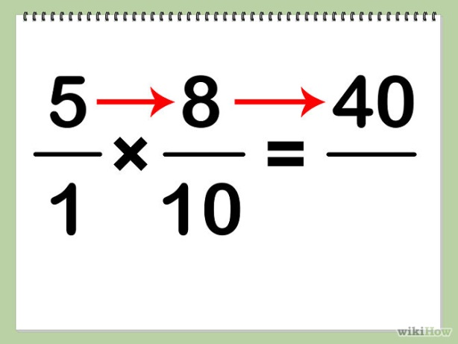
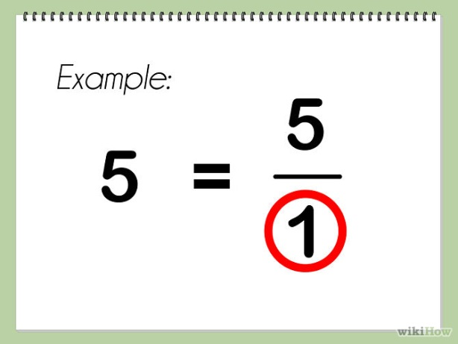
multiply fractions & whole numbers
©2014-2015 Caryn Dingman www.mrsdingman.com
enVision Topic 11
PA Core Assessment Anchor MO5.A-F

Slide 3
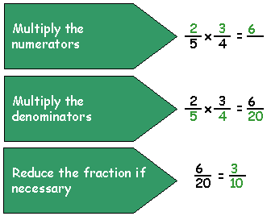
multiply 2 fractions
©2014-2015 Caryn Dingman www.mrsdingman.com
enVision Topic 11
PA Core Assessment Anchor MO5.A-F

Slide 4
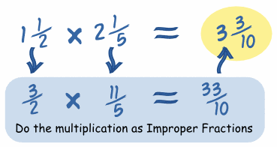
multiply mixed numbers
1.) change to improper fractions
2.) multiply numerators
3.) multiply denominators
4.) simplify product
©2014-2015 Caryn Dingman www.mrsdingman.com
enVision Topic 11
PA Core Assessment Anchor MO5.A-F

Slide 5
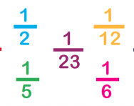
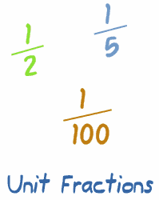
unit fraction
* any fraction with a “1” in the numerator
©2014-2015 Caryn Dingman www.mrsdingman.com
enVision Topic 11
PA Core Assessment Anchor MO5.A-F

Slide 6

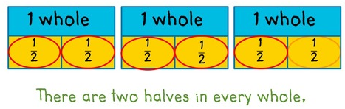
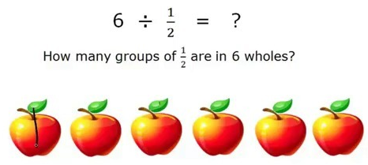
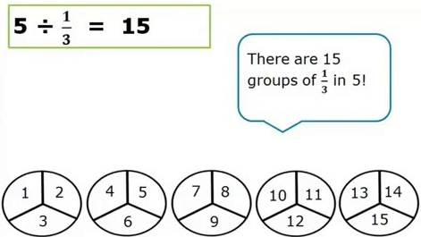
divide whole number by unit fraction
©2014-2015 Caryn Dingman www.mrsdingman.com
enVision Topic 11
PA Core Assessment Anchor MO5.A-F

Slide 7
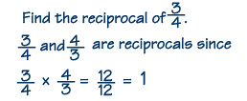
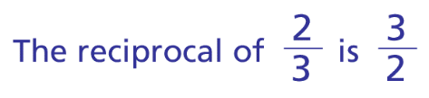

reciprocal
* one fraction is the reciprocal of another if their product is 1
©2014-2015 Caryn Dingman www.mrsdingman.com
enVision Topic 11
PA Core Assessment Anchor MO5.A-F

