Slide 1
Math Vocabulary
Numbers and Operations M05.A-F add & subtract fractions & mixed numbers
Aligning with
Pennsylvania Department of Education
Core Assessment Anchors
and enVision Math Textbook Topic 10
©2014 Caryn Dingman
www.mrsdingman.com

Slide 2
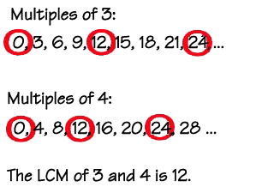
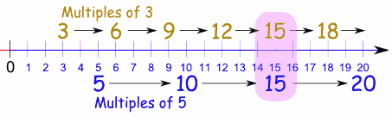
least common multiple
* also called LCM
* list products of both denominators
* smallest product in both lists is LCM
©2014 Caryn Dingman www.mrsdingman.com
enVision Topic 10
PA Core Assessment Anchor MO5.A-F

Slide 3
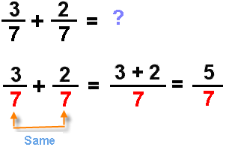
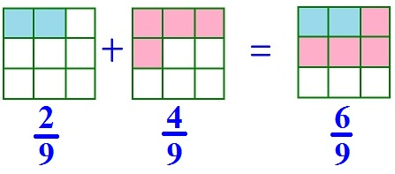
adding fractions
* if the denominators are the SAME:
* add the numerators
* leave the denominators the same
©2014 Caryn Dingman www.mrsdingman.com
enVision Topic 10
PA Core Assessment Anchor MO5.A-F

Slide 4
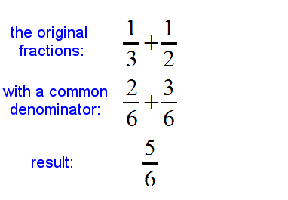
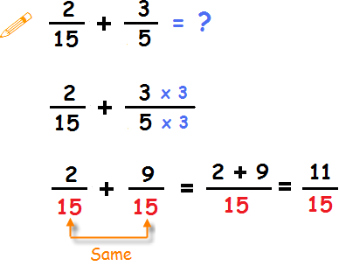
adding fractions
* if the denominators are DIFFERENT:
* find the LCM
* create equivalent fraction
* once denominators are the same, add numerators
©2014 Caryn Dingman www.mrsdingman.com
enVision Topic 10
PA Core Assessment Anchor MO5.A-F

Slide 5
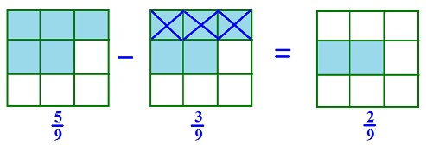


subtracting fractions
* if the denominators are the SAME:
* subtract the numerators as if they are whole numbers
* leave the denominators the same
©2014 Caryn Dingman www.mrsdingman.com
enVision Topic 10
PA Core Assessment Anchor MO5.A-F

Slide 6
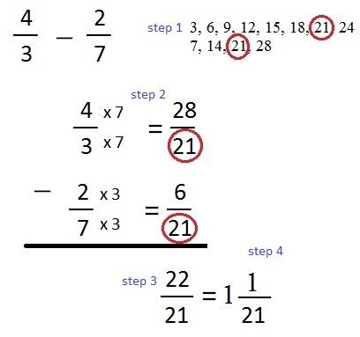
subtracting fractions
* if the denominators are DIFFERENT:
* find the LCM
* create equivalent fraction
* once denominators are the same, subtract numerators
©2014 Caryn Dingman
www.mrsdingman.com
enVision Topic 10
PA Core Assessment Anchor MO5.A-F

Slide 7
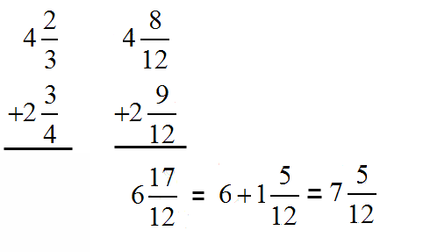
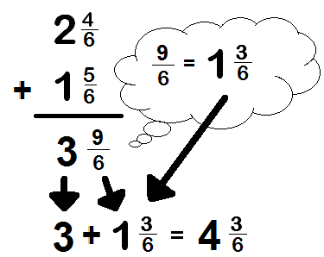
adding mixed numbers
* if the denominators are the SAME:
©2014 Caryn Dingman
www.mrsdingman.com
enVision Topic 10
PA Core Assessment Anchor MO5.A-F

Slide 8
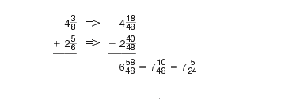
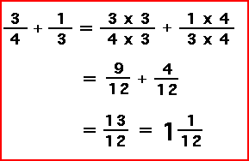
adding mixed numbers
* if the denominators are DIFFERENT:
©2014 Caryn Dingman
www.mrsdingman.com
enVision Topic 10
PA Core Assessment Anchor MO5.A-F

Slide 9

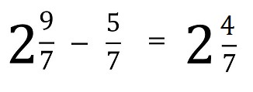
subtracting mixed numbers
* if the denominators are the SAME:
©2014 Caryn Dingman
www.mrsdingman.com
enVision Topic 10
PA Core Assessment Anchor MO5.A-F

Slide 10

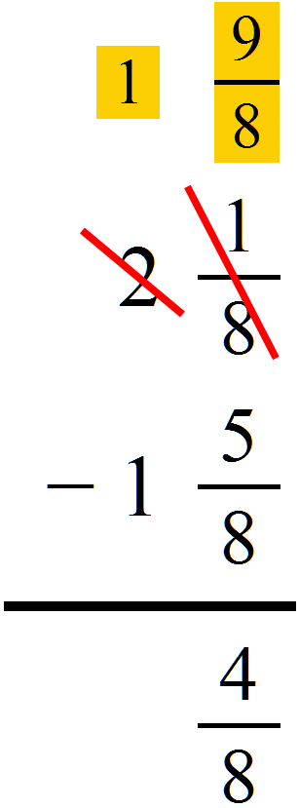
subtracting mixed numbers
* if the denominators are DIFFERENT:
©2014 Caryn Dingman
www.mrsdingman.com
enVision Topic 10
PA Core Assessment Anchor MO5.A-F

