Slide 1
Math Vocabulary Operations and Algebraic Thinking M05.B-O solving & writing equations
Aligning with
Pennsylvania Department of Education
Core Assessment Anchors
and enVision Math Textbook Topic 15
©2011-2014 Caryn Dingman
www.mrsdingman.com

Slide 2
equation
* a number sentence
* may have variables
* has an equal sign
* has an answer part
©2011-2014 Caryn Dingman www.mrsdingman.com
enVision Topic 15
PA Core Assessment Anchor MO5.B-O

Slide 3
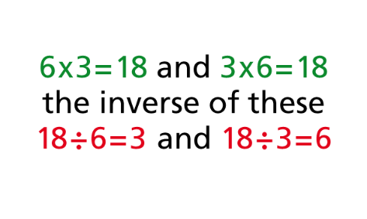
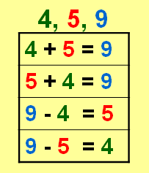
inverse operations
* inverse – opposite (synonyms)
* addition and subtraction are inverse operations
* multiplication and division are inverse operations
©2011-2014 Caryn Dingman www.mrsdingman.com
enVision Topic 15
PA Core Assessment Anchor MO5.B-O

Slide 4
isolate a variable
* leave a variable alone or by itself on one side of an equal sign
* use inverse operations to isolate the variable
* variable is usually placed by itself, or isolated, on the left side of equation
©2011-2014 Caryn Dingman www.mrsdingman.com
enVision Topic 15
PA Core Assessment Anchor MO5.B-O

Slide 5
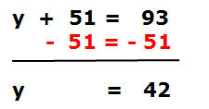
solving addition equations
* use subtraction on both sides to isolate variable
©2011-2014 Caryn Dingman www.mrsdingman.com
enVision Topic 15
PA Core Assessment Anchor MO5.B-O

Slide 6
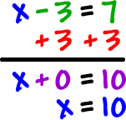
solving subtraction equations
* use addition on both sides to isolate variable
©2011-2014 Caryn Dingman www.mrsdingman.com
enVision Topic 15
PA Core Assessment Anchor MO5.B-O

Slide 7
solving multiplication equations
* use division on both sides to isolate variable
©2011-2014 Caryn Dingman www.mrsdingman.com
enVision Topic 15
PA Core Assessment Anchor MO5.B-O

Slide 8
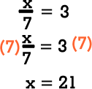
solving division equations
* use multiplication on both sides to isolate variable
©2011-2014 Caryn Dingman www.mrsdingman.com
enVision Topic 15
PA Core Assessment Anchor MO5.B-O

