Slide 1
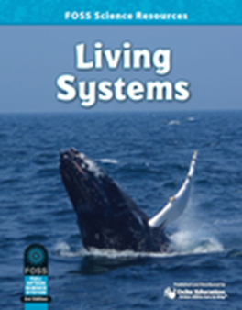
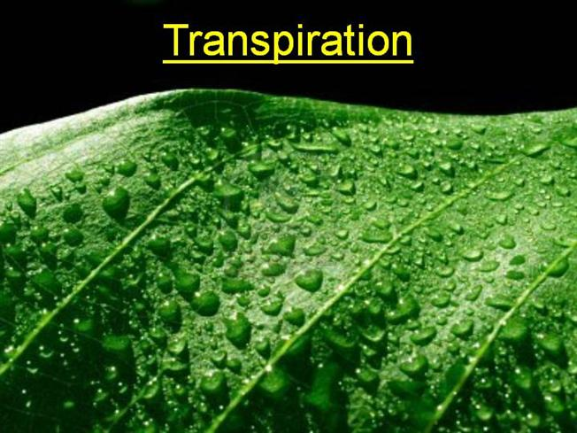
Investigation 3
Focus Question:
How are nutrients transported
to cells in a plant?
Source: FOSS Living Systems Investigation 3 and
adapted experiment from: “The Colorful Celery Experiment”/
free resource teacherspayteachers.com/ Tracey Schumacher
developed by Caryn Dingman December 2015

Slide 2
Investigation 3
Each group will have:
* 2 celery stalks (one with leaves and one without)
* each celery stalk will be placed in a cup of colored water
In your small group, discuss ideas for the
Colorful Celery Investigation hypothesis, or prediction.
Record your prediction ideas
in your Science Notebook.
Make sure your hypothesis includes what you think will happen to BOTH stalks of celery.
developed by Caryn Dingman December 2015

Slide 3
Investigation 3
1.) Each group will have 2 plastic cups filled with water.
2.) Place a few drops of blue food coloring in each cup, turning the water blue.
3.) Place one celery stalk without leaves in one plastic cup. Place one celery stalk with leaves in the other plastic cup.
developed by Caryn Dingman December 2015

Slide 4
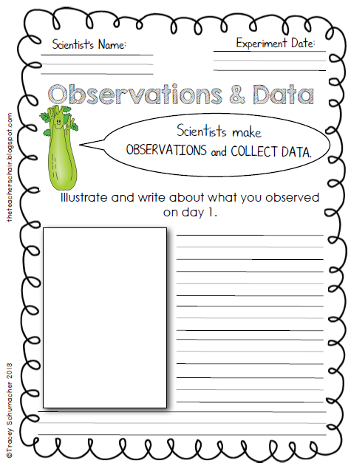
Investigation 3
Discuss your observations with your group and record in your Science Notebooks, using the data sheets we have for this Investigation.
developed by Caryn Dingman December 2015

Slide 5
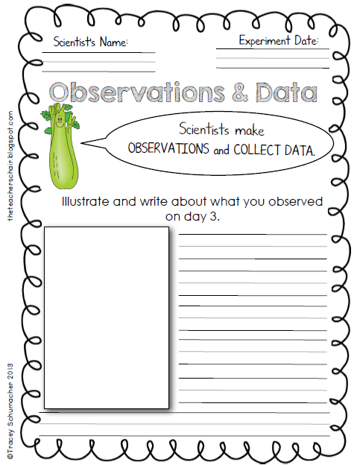
Investigation 3
Discuss your observations with your group and record in your Science Notebooks, using the data sheets we have for this Investigation.
developed by Caryn Dingman December 2015

Slide 6
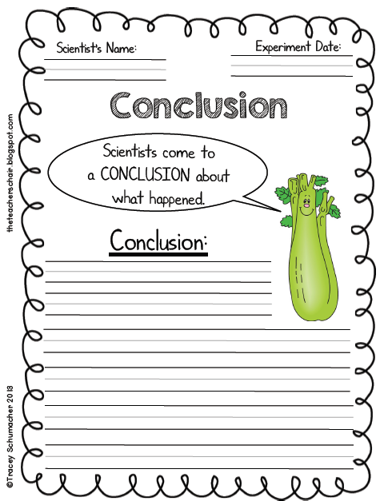
Investigation 3
Discuss your conclusions with your group and record in your Science Notebooks, using the data sheets we have for this Investigation.
developed by Caryn Dingman December 2015

Slide 7
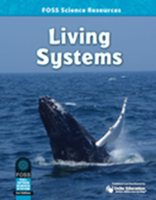
Investigation 3
Let’s Answer
the Focus Question:
How are nutrients
transported
to cells in a plant?
* water travels in plants through long, thin tubes called xylem
* xylem run from the roots
through the stems and leaves
* transpiration is the way water moves through a plant from the roots to the leaves and out into the air
* transpiration is a pulling force that helps plants get rid of extra water in their leaves that’s not needed
* this “pull” or lift brings water and nutrients to the leaves from the roots of a plant
developed by Caryn Dingman December 2015

