Slide 1
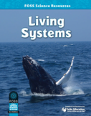
Investigation 2
Focus Question:
What does yeast need
to break its dormancy?
developed by Caryn Dingman July 2015

Slide 2
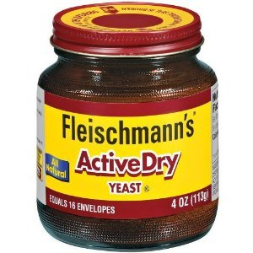
Investigation 2
Yeast is a living organism.
* yeast is not an animal or a plant
* yeast is a fungus and has only one cell
* yeast can’t make its own food
* until you give yeast food, it’s like yeast is asleep or dormant
What do you think yeast might need
to become active?
developed by Caryn Dingman July 2015

Slide 3
Investigation 2
1.) Fill 2 water bottles with ¼ cup very warm water.
Label 1 bottle “S” and the other bottle “F” with the sharpie marker.
2.) Add ½ teaspoon sugar to the “S” bottle and ½ teaspoon flour to the “F” bottle.
3.) Add 1 packet of dry yeast to each bottle and gently swirl the contents to mix them a bit
4.) Place a balloon over the top of each bottle and observe what happens.
developed by Caryn Dingman July 2015

Slide 4
Investigation 2 Part 1B
1.) In your Science Notebooks make a drawing of each bottle. Label your drawings to make them clear.
2.) Describe what happened to both bottles.
developed by Caryn Dingman July 2015

Slide 5
Investigation 2
Let’s answer the
Focus Question:
What does yeast need to break its dormancy?
Sugar is what yeast needs to “wake it up” or break its dormancy.
Carbon dioxide gas is released when yeast is eating.
Yeast “eats” by absorbing sugar through its membrane.
The balloon inflating over the bottle with the sugar shows carbon dioxide release.
developed by Caryn Dingman July 2015

