Slide 1
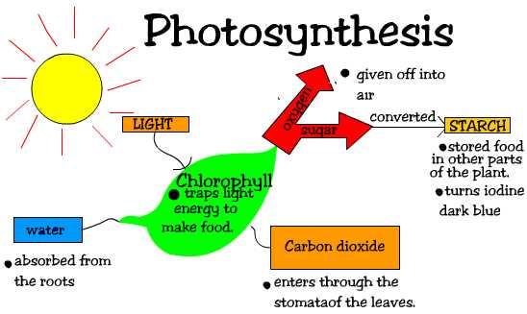
Investigation 2
Focus Question:
Why Do Leaves Change Colors?
Source: FOSS Living Systems Investigation 2 and
adapted experiment from: http://www.motherhoodonadime.com/kids/why-do-leaves-change-colors-a-science-experiment-with-kids/
developed by Caryn Dingman December 2015

Slide 2
Investigation 2
* photosynthesis is a process that produces chlorophyll
* chlorophyll is a chemical that makes leaves green
In your small group, discuss your ideas for the Investigation prediction.
Record your ideas in your Science Notebook.
developed by Caryn Dingman December 2015

Slide 3
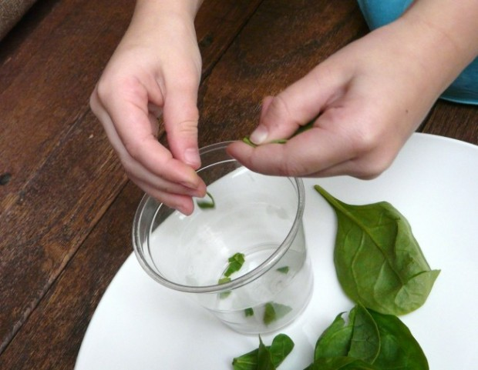
Investigation 2
1.) Tear spinach leaves into small bits and place in the plastic cup.
developed by Caryn Dingman December 2015

Slide 4
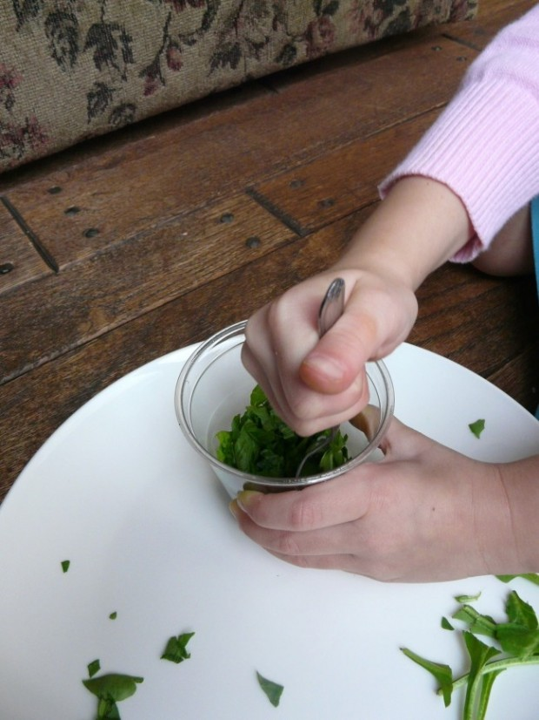
Investigation 2
2.) Mash the spinach bits with the spoon.
developed by Caryn Dingman December 2015

Slide 5
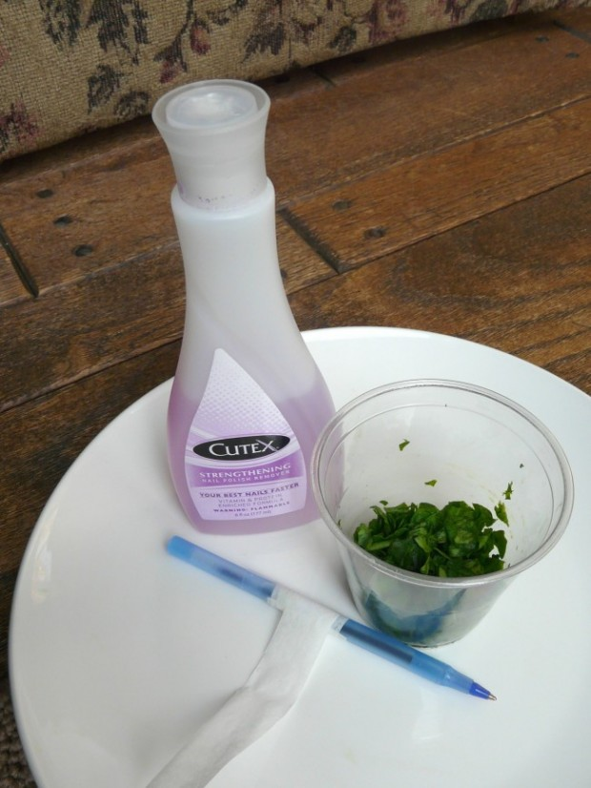
Investigation 2
3.) Add nail polish remover to cover the spinach bits in the cup.
developed by Caryn Dingman December 2015

Slide 6
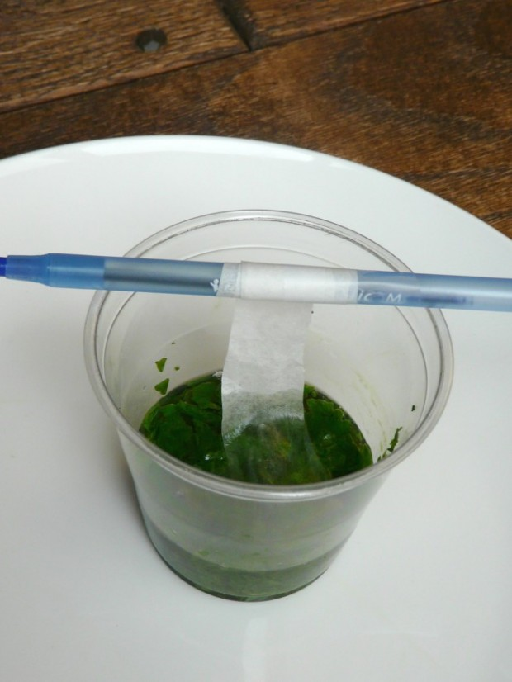
Investigation 2
4.) Take a coffee filter strip and wrap one end around the pencil, taping it in place.
developed by Caryn Dingman December 2015

Slide 7
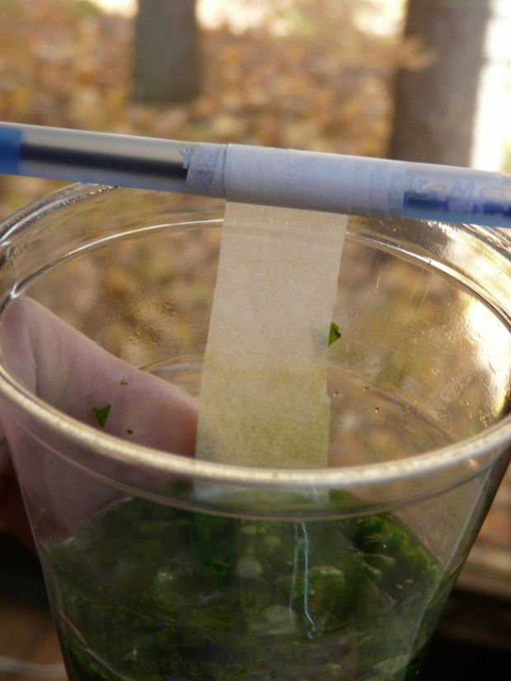
Investigation 2
5.) Place the pencil across the top of the cup and observe what happens.
Discuss your observations with your group and record in your Science Notebooks, using the data sheets we glued in for this Investigation.
developed by Caryn Dingman December 2015

Slide 8
Investigation 2
Let’s Answer
the Focus Question:
Why do leaves change colors?
* leaves are green because of the chemical chlorophyll
* other chemicals in the leaves produce the reds, oranges, and yellows we see in the fall
* the process of photosynthesis produces chlorophyll during spring and summer when the days are longer
* as days grow shorter, less chlorophyll is made allowing other colors to show
* the nail polish remover broke down the leaves to release the chemicals and colors
developed by Caryn Dingman December 2015

