Slide 1
Investigation 1
Part 3
Focus Question:
What happens when compost worms interact with organic litter?
developed by Caryn Dingman July 2015

Slide 2
Investigation 1
Part 3
decomposers:
* subsystem in every ecosystem
* consume waste, dead plants, dead animals
* 2 groups- grinders and finishers
* grinders: ants, worms, snails
* finishers leave organic material behind for plants
developed by Caryn Dingman July 2015

Slide 3
Investigation 1
Part 3
1.) Put about 1-2 cm garden soil in jar
2.) Tear two large sheets of newspaper into thin strips. Moisten the paper strips with water. They should be moist, but not dripping wet. A spray mister is a good way to moisten the newspaper.
3.) Fill the jar with the damp newspaper strips until it is almost full, about 6–7 cm from the top.
4.) Add some natural leaf litter (five or six dead leaves, two or three dead twigs) and a small amount of fresh household waste (apple cores, lettuce scraps, crushed eggshells, coffee grounds, melon rinds, etc.).
developed by Caryn Dingman July 2015

Slide 4
Investigation 1
Part 3
5.) When the materials are all in the jar, screw on the lid and give the container a shake to mix the contents a bit.
6.) If necessary, use a spray mister to moisten the habitat. The contents should be very moist, but not dripping wet.
7.) When the container is ready, count 15–18 red worms and drop them into the container. Screw on the lid. It has air holes for ventilation.
developed by Caryn Dingman July 2015

Slide 5
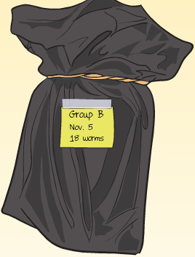
Investigation 1
Part 3
In their natural habitat, worms live under a cover of dead leaves. It’s pretty dark in there!
Let’s make the containers as dark as we can.
Place your worm habitat inside the black plastic bag, securing it with an elastic band.
developed by Caryn Dingman July 2015

Slide 6
Investigation 1
Part 3
In your Science Notebooks, copy and answer these questions:
1.) Is your worm habitat a system? Make a list of its parts.
2.) What do you think will happen to your worm habitat over time?
developed by Caryn Dingman July 2015

Slide 7
Investigation 1
Part 3
Let’s answer the
Focus Question:
(after a few weeks)
What happens when compost worms interact with organic litter?
developed by Caryn Dingman July 2015

