Slide 1
Investigation 1
Part 2
Focus Question:
Is planet Earth a system?
developed by Caryn Dingman July 2015

Slide 2
Investigation 1 Part 2
Let’s watch 2 short video to learn
about Earth’s spheres.
Four Spheres Part 1
https://www.youtube.com/watch?v=VMxjzWHbyFM
YouTube length 4:00
Four Spheres Part 2
https://www.youtube.com/watch?v=UXh_7wbnS3A
YouTube length 3:30
developed by Caryn Dingman July 2015

Slide 3
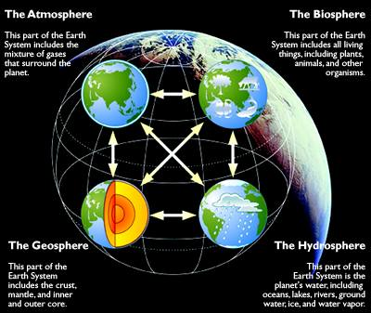
Investigation 1 Part 2
vocabulary to add to our Science Notebooks
developed by Caryn Dingman July 2015

Slide 4
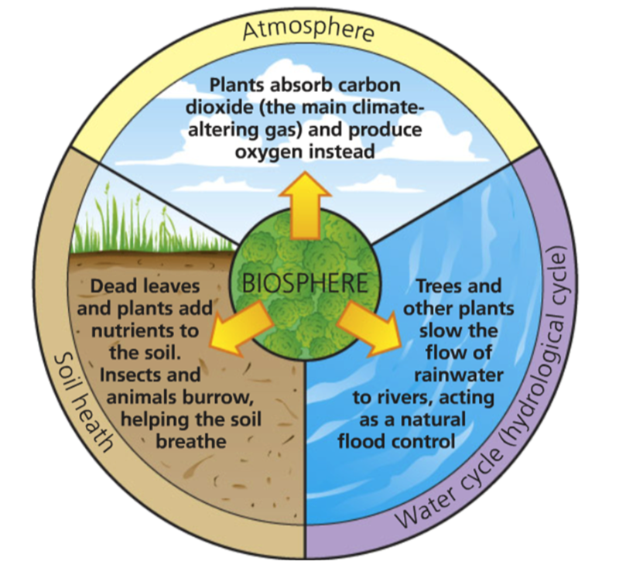
Investigation 1 Part 2
Is the biosphere a subsystem?
developed by Caryn Dingman July 2015

Slide 5
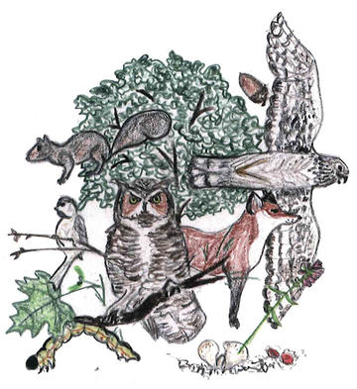
Investigation 1 Part 2
Woods Ecosystem Cards
* each group will get a set of 20 cards
* each card describes an organism that lives in a woods or forest ecosystem
* some organisms live on land and some live in the water
Which organisms go together because one of them eats the other?
developed by Caryn Dingman July 2015

Slide 6
Investigation 1 Part 2
vocabulary to add to our
Science Notebooks
food chain:
path that food takes from one organism to another
producers:
organisms that make food using energy from the Sun
consumers:
organisms that eat other organisms
herbivores:
animals that eat plants
carnivores:
animals that eat other animals
omnivores:
animals that eat plants and other animals
decomposers:
organisms that break down or recycle dead organisms
developed by Caryn Dingman July 2015

Slide 7
Investigation 1
Part 2
Let’s answer the
Focus Question:
Is planet Earth a system?
Discuss this with your group.
Write about it in your Science Notebooks.
developed by Caryn Dingman July 2015

