Slide 1

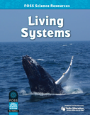
Investigation 1
Part 1
Focus Question:
How can you identify a system?
developed by Caryn Dingman July 2015

Slide 2
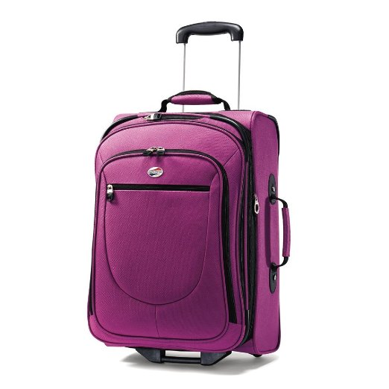
Investigation 1 Part 1
This is a system that has been designed for efficient transportation of clothes and personal items while traveling.
What would you call a system like this?
developed by Caryn Dingman July 2015

Slide 3
Investigation 1 Part 1
What are the interacting parts that make up this suitcase?
* copy the question into your Science Notebook
* make a list of interacting parts with your group
developed by Caryn Dingman July 2015

Slide 4
Investigation 1 Part 1
system:
any collection of interacting parts that work together to make a whole OR produce or perform a function
developed by Caryn Dingman July 2015

Slide 5
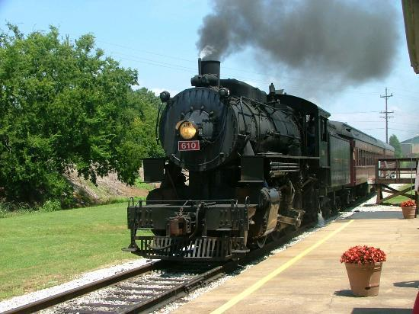
Investigation 1 Part 1
A railroad is a transportation system.
Railroad systems transport people and materials.
Write the word “railroad” in your Science Notebook.
Make a list with your group of interacting parts to describe it.
developed by Caryn Dingman July 2015

Slide 6
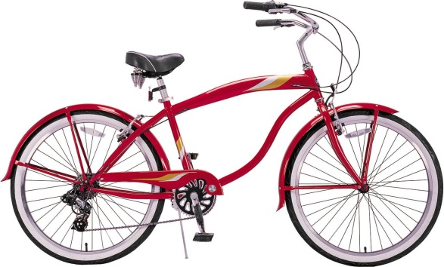
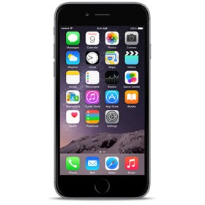

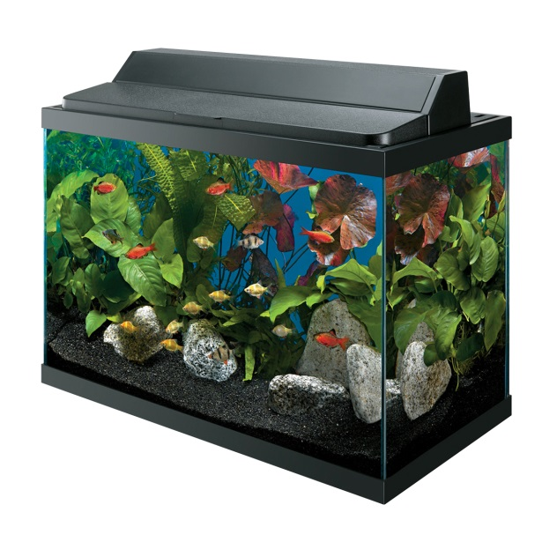
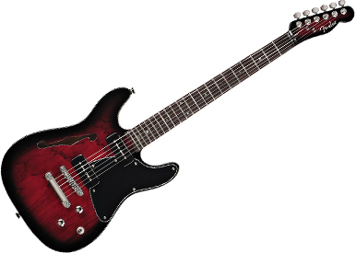
Investigation 1 Part 1
Let’s analyze some systems!
developed by Caryn Dingman July 2015

Slide 7
Investigation 1 Part 1
* Make a list of interacting parts.
What happens if any parts of the system are missing or break down?
developed by Caryn Dingman July 2015

Slide 8
Investigation 1
Part 1
Let’s answer the
Focus Question:
A system can be simple, like a pencil or a paper clip.
A system can be complex, like a TV or an airplane.
Complex systems will usually have subsystems, or systems within systems.
developed by Caryn Dingman July 2015

