Slide 1
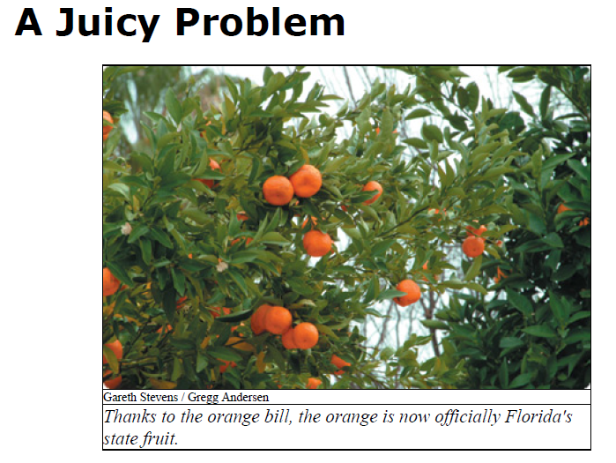
Source: ReadWorks.org

Slide 2
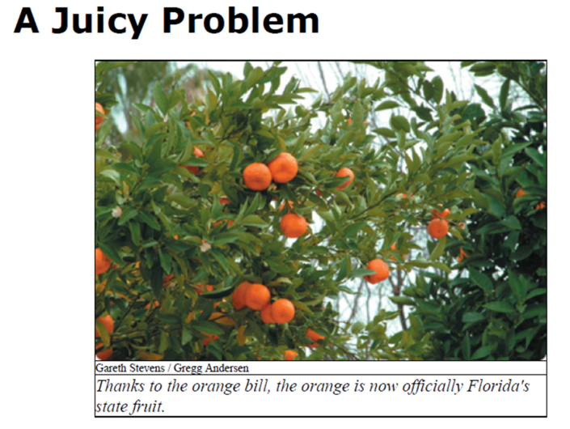
1. The title uses the word “juicy” figuratively to mean
a. cold and wonderful.
b. tasty and delightful.
c. powerful and absorbing.
d. fruity and sticky.
Source: ReadWorks.org

Slide 3

The title uses the word “juicy” figuratively to mean
a. cold and wonderful.
b. tasty and delightful.
c. powerful and absorbing.
d. fruity and sticky.
Source: ReadWorks.org

Slide 4
The fourth grade class probably found it surprising that the orange was not already the Florida state fruit because
a. the famous football game in Florida is called the Orange Bowl.
b. Florida grows so many oranges.
c. ads often feature “Florida orange juice.”
d. all of the above.
Source: ReadWorks.org

Slide 5
The fourth grade class probably found it surprising that the orange was not already the Florida state fruit because
a. the famous football game in Florida is called the Orange Bowl.
b. Florida grows so many oranges.
c. ads often feature “Florida orange juice.”
d. all of the above.
Source: ReadWorks.org

Slide 6
The pun “the fruits of their labor” refers both to oranges and to
a. results.
b. troubles.
c. efforts.
d. aims.
Source: ReadWorks.org

Slide 7
The pun “the fruits of their labor” refers both to oranges and to
a. results.
b. troubles.
c. efforts.
d. aims.
Source: ReadWorks.org

Slide 8
“To that end” means
a. toward the furthest place.
b. to achieve that result.
c. don’t go the other way.
d. none of the above.
Source: ReadWorks.org

Slide 9
“To that end” means
a. toward the furthest place.
b. to achieve that result.
c. don’t go the other way.
d. none of the above.
Source: ReadWorks.org

Slide 10
What text evidence helps us know it takes more than one person to make a law?
Source: ReadWorks.org

Slide 11
Answers will vary but should mention:
petitioning
committees
state representative to introduce legislation
governor to sign
Source: ReadWorks.org

