Slide 1
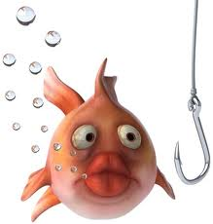
Hook Your Reader
It is important to attract the reader’s attention right from the start
so they want to read the story or paragraph.
A “hook” is a one-sentence device
placed at the beginning of a story OR a paragraph
and generates curiosity in the reader.
Developed by Caryn Dingman DDES October 2015

Slide 2

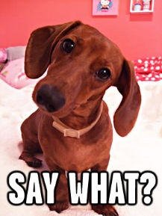



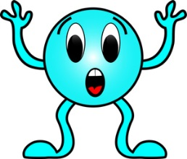
Hook Your Reader
OK…
What are some ways we can do this?
single word or fragment
begin with a question
dialogue
figurative language
cliff hanger
strong opinion
Developed by Caryn Dingman DDES October 2015

Slide 3
Hook Your Reader
Begin with a question.
What could be worse than spending the night in a haunted house?
Developed by Caryn Dingman DDES October 2015

Slide 4
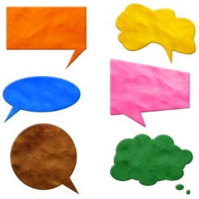
Hook Your Reader
Use dialogue.
“Run and don’t look back!” shouted Sammy.
Developed by Caryn Dingman DDES October 2015

Slide 5
Hook Your Reader
Start with a strong opinion.
There are no such things as ghosts!
Developed by Caryn Dingman DDES October 2015

Slide 6
Hook Your Reader
Start with a single word
or phrase.
Me? Scared?
Developed by Caryn Dingman DDES October 2015

Slide 7
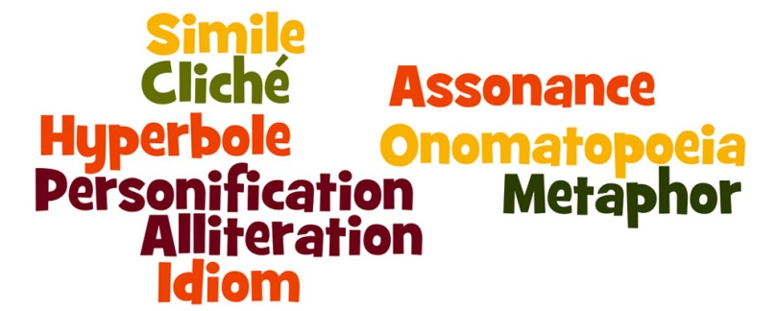
Hook Your Reader
Begin with
figurative language.
That pumpkin was
as big as a school bus!
Developed by Caryn Dingman DDES October 2015

Slide 8
Hook Your Reader
Leave your reader wondering.
There was a sound coming from the attic, and I knew it wasn’t a mouse.
Developed by Caryn Dingman DDES October 2015

Slide 9
Hook Your Reader
Let’s try some of these in our own writing!
single word or fragment
begin with a question
dialogue
figurative language
cliff hanger
strong opinion
Developed by Caryn Dingman DDES October 2015

