Slide 1
Dear Mrs. Dingman,
My student was absent from school yesterday because…

Slide 3
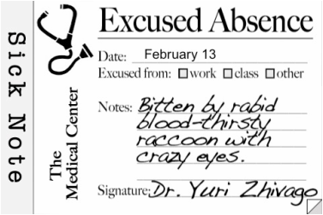

Slide 4
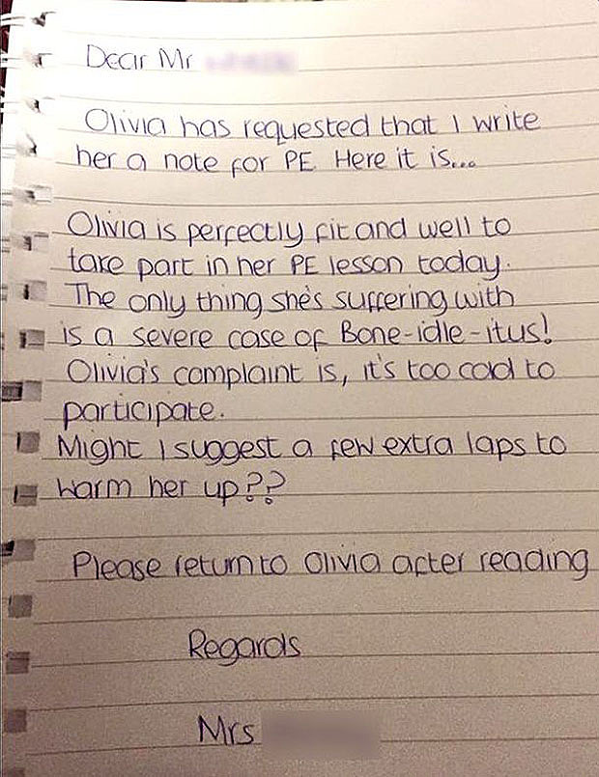

Slide 5
March 9, 2006
Dear Mrs. Dingman, Piper couldn’t go to school yesterday because Saturday we went to the beach, and sat under a coconut tree for shade. Piper got hit in the head with a coconut and was knocked unconscious. I took her to the hospital. The doctors said she wouldn’t wake-up for 72 hours.
Also, if Piper says things that sound crazy like she went to a baseball game or something, it’s because her medicine makes her wacky. Thank you!
Sincerely,
Maggie

Slide 6
Excuses, Excuses
Rough Draft
Pretend that you are an adult… with children of your own…
Your son or daughter wants to miss a day of school to attend a really cool sporting event or concert.
Write an excuse note to me for the missed day of school. Did Bobby’s tight shoes cause a severe toe injury? Did Sally’s dog eat all of her clothes, so she needed an emergency shopping trip?
Be creative! Use hyperbole! ☺

Slide 7
Excuses, Excuses
Revise & Edit WITH PEN
* STRONG introductory sentence
* STRONG ending sentence
* added interesting adjectives, using caret marks
* found & used interesting synonyms
* all sentences express complete thoughts
* paragraphs indented
* capitalization, punctuation, spacing, spelling ☺
* friendly letter format followed

