Slide 1
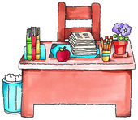
Welcome to 5th Grade
Class Rules and Important Things to Remember

Slide 2
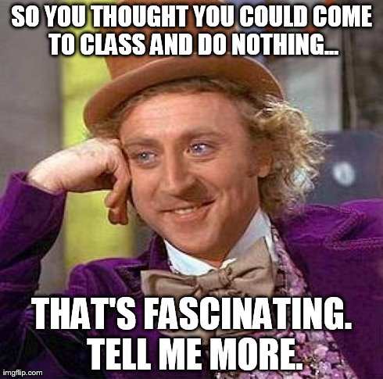
Entering The Classroom
Be in your seat by 9:05am.
Follow the Morning Work Board directions in number order.
All materials should be in your desk.
Always have something to read.
Have sneakers in the classroom if it’s a Phys Ed day.

Slide 3
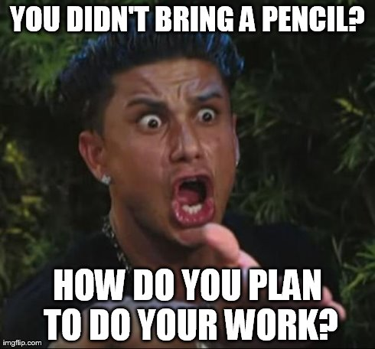
Be Prepared
Have all textbooks, folders, and homework in the classroom.
You must have a Reading Counts book at ALL times.
Please be sure to have a pencil and a pen every day!

Slide 4
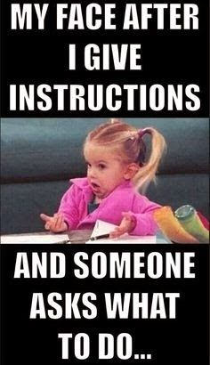
Respect
Listen when students or adults are talking.
Follow directions the 1st time they were given.
Keep hands and feet to self.
Do not touch other people’s belongings, unless you have permission. This includes items on my desk.

Slide 5

Grades
Tests
Quizzes & Classwork
Homework
Participation and Preparation

Slide 6
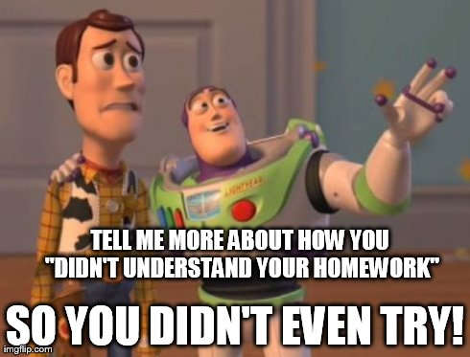
Homework
Homework will be assigned just about every night.
Homework is due in the beginning of class and checked daily.
I expect you to make an honest attempt and TRY YOUR BEST.

Slide 7
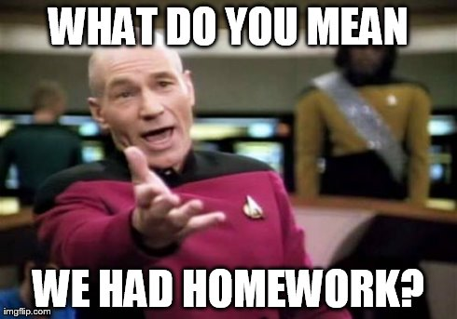
Homework
Homework counts toward your overall grade.
Homework is not to be done in class.
Homework should be recorded on your Homework Assignment sheet. You will have class time to do this.
If ever in doubt, call the Homework Hotline.

Slide 8
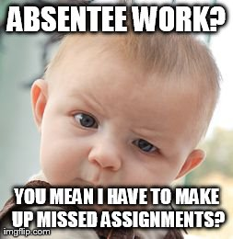
Absences
Place absentee note on my desk.
A We Missed You paper has been prepared for your missed assignments.
You have the same number of days absent to make up the work.
Place assignments WITH the We Missed You cover sheet on my desk when due.
This is YOUR responsibility.

Slide 9
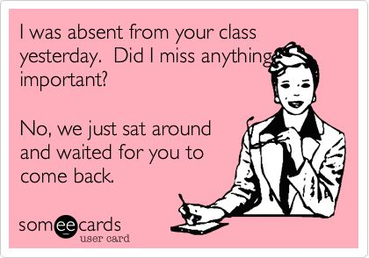
Absences
If absent on a day of a test, you will take the test the day you return.
Go to your music lesson on time. We’ll catch up when you get back.
If you know you will be missing class, please let me know ahead of time so I can try to prepare work for you.

Slide 10
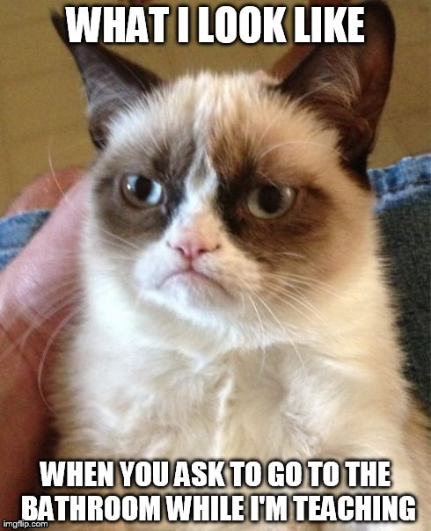
Bathroom
Please use the bathroom BEFORE class starts.
Once directions have been given and we’ve started working, you may ask bathroom permission.
You will ALWAYS need to sign out.

Slide 11
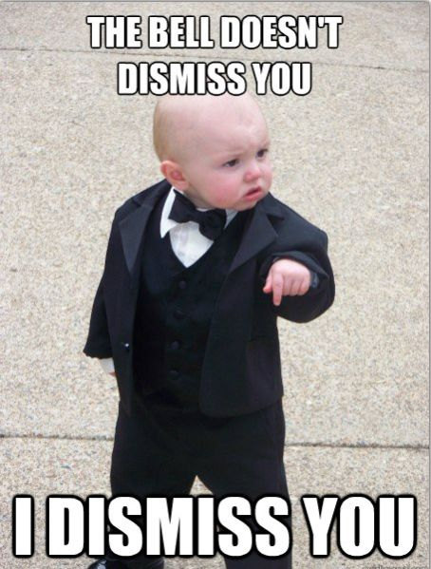
Dismissal
I will let you know when it is ok to pack up.
Please clean your area of any garbage.
When it’s time to go to lunch or a special, please wait until I dismiss you.

Slide 12
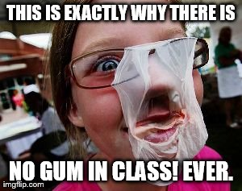
#enoughsaid?

Slide 13
